Slide 1
Cyberbullying
For Parents of Primary School Children

Slide 2
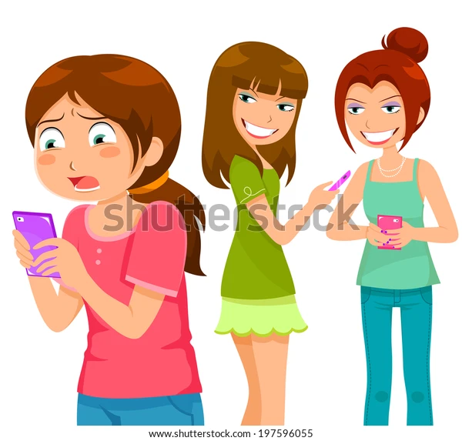
Cyberbullying
What is it & How To Manage It

Slide 3
Contents
Defining Cyberbullying
Components of Cyberbullying
What Constitutes Cyberbullying - Cause & Effect
Who’s at Risk
Advice for Parents / Guardians
Additional Support

Slide 4
Cyberbullying Definition
“An aggressive act or behaviour that is carried out using electronic means by a group or individual repeatedly & over time against a victim who cannot easily defend him or herself”
(Smith et al, 2008)

Slide 5
Components - Cyberbullying
There are three components that must be recognised when it comes to a broad definition of bullying
Intention to do harm
A repeated act of behaviour
An imbalance of power

Slide 6
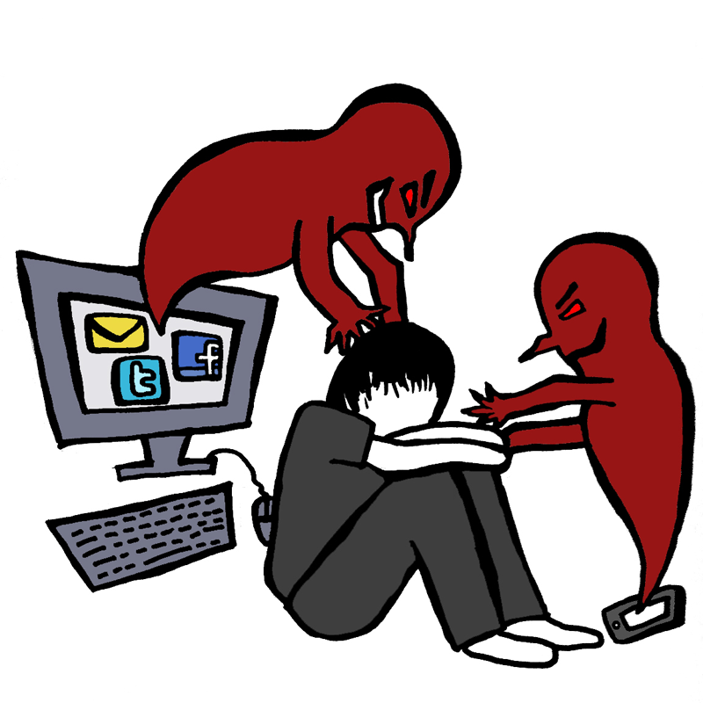
Forms - Cyberbullying
Sending mean text messages or IMs to someone
Pranking someone’s mobile phone
Pretending to be someone else to spread hurtful messages online
Spreading secrets or rumours about someone online
Being rude or mean to someone in an online game
Tricking someone into revealing personal information & then
forwarding that information to others

Slide 7
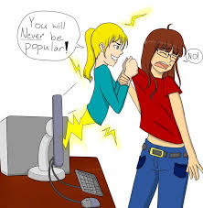
Dangers - Cyberbullying
Internet anonymity empowers bullies
It can occur 24/7
It can be distributed quickly to a wide audience
Difficult & sometimes impossible to trace the source
Deleting harassing texts, messages & pictures is extremely
difficult once posted / distributed
Adversely impacting emotional well-being

Slide 8
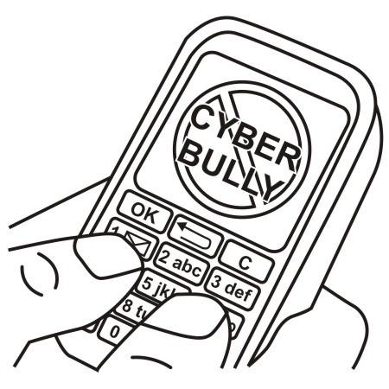
Signs - Cyberbullying
Being emotionally upset
Being secretive or protective of digital use
Spending more time than usual in their room
Withdrawal from/lack of interest in family, friends & activities
Avoiding school or social gatherings
Slippage in school work
Suddenly wants to stop using devices
Change in mood, sleep or appetite
Being nervous or jumpy when receiving a message, text or email

Slide 9
Motives - Cyberbullying
The problem is not the technology & Communication tools used - it is rooted in relationships
& how people interact with each other
Usually a connection to offline life - school life
Tension & conflict in class
Jealousy
Fit in with a group of friends or clique / Peer pressure
False sense of security
Friendship breakdown
Meanness
Revenge
Looking cool

Slide 10
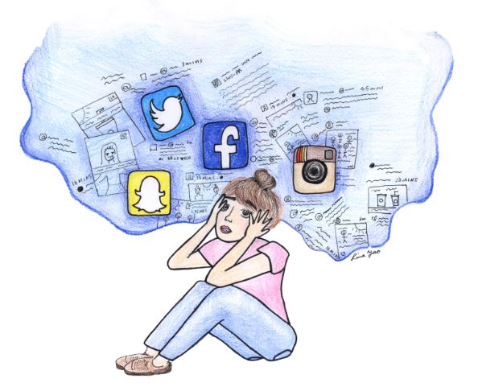
Effects of Cyberbullying
Damage to Emotional Well-being
Powerlessness & Fear
Distress / Sadness / Tearfulness
Social Anxiety Panic Attacks
Poor Concentration Poor Academic Performance
Loneliness
Lack of Confidence & Self-esteem

Slide 11
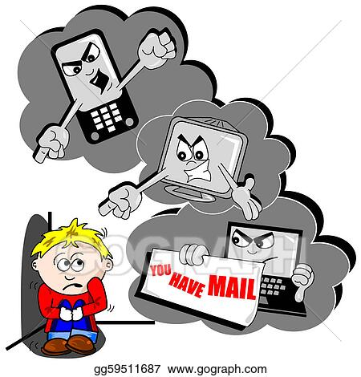
Characteristics - Cyberbullying
Power Imbalance
Repetition
Deliberate
Perpetrator Anonymity
Disinhibition
Wide Reaching
Access day or night
Emotional / Social Harm
Boredom
Misplaced Anger
Unthinking
False Fun
Low Empathy
Moral Disengagement
Hurt the feelings of others
Dominant

Slide 12
Who’s at Risk - Cyberbullying
Any child can be bullied for any reason
If a child is seen as different in some way or an easy target they can be more at risk
Race or ethnic background
Appear anxious or have low-self-esteem
Lack of assertiveness
Shy or introverted
Popular or successful
Special needs

Slide 13
What can Parents & Guardians do?

Slide 14
Have a conversation early..
Encourage your child to be compassionate & responsible when interacting
online
Take the time to talk to your child about ways to keep themselves safe online
Agree on a clear set of rules
Encourage your child to ask for help
Lead by example
Get involved & join in

Slide 15
What else ?
Role Play
Talk about friendships
Champion uniqueness
The importance of saying sorry

Slide 16
Advice for Parents
Ask for help - Reassure your child that they can always come to you to
talk about anything that bothers then online
It is not their fault - Advise your child that if someone is repeatedly
cruel to them either face to face or online that is bullying & no-one
deserves to be treated that way
Listen - Don’t interrogate your child or overreact - by
coming to you looking for help, they have demonstrated trust in you
Be clear-Tell your child that once you have identified that online
bullying has taken place, you will need to talk with their teachers &
the parents of other children involved

Slide 17
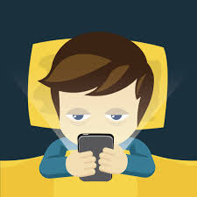
Advice for Parents/Guardians
Don’t Respond - Encourage your child not to respond to
messages that annoy or harass - the bully wants to get a reaction
from their target
Keep the Bullying Messages - Ensure your child retains a
record / evidence of bullying dates & times for school or Garda
investigation
Block the Sender - Use the technology block in messaging
apps/social networking
Talk to your child’s teacher if the bullying is school related
Schools must have an Anti-bullying policy in place

Slide 18
Advice for Parents
Report Incidents - Report cyberbullying to websites, apps or
service providers
Tell the person to stop - Only if your child feels comfortable to do
so as they will need to make their position clear that they will
not stand for this treatment
Think before you post - Encourage your child to self-reflect before they post -
ask them to think “ will I regret this later”, “would I say this in person”,“Would I
like me”, “Am I being kind”, “Could this be interpreted differently”

Slide 19
Advice for Parents
Inform - Give your child advice to protect themselves online & to show them how
to protect their account and devices
Privacy - Encourage your child to keep personal information private
Limit access to technology - Keep the computer in a public place
in the home & encourage your child to resist the temptation
of continuously checking websites / phone for new messages

Slide 20
Advice for Parents
Support - Encourage your child to always seek support from
parent/guardian, school counsellor, principal or teachers - make
them aware of the support available
Be part of the child’s online world - Ask to “friend” or “follow” your
child on social media sites - but do not abuse the privilege by
commenting or posting anything on your child’s profile
Talk & chat - Encourage your child to talk to you about
cyberbullying - positive & open communication is key to dealing with
online bullying

Slide 21
Advice for Parents
Build your child’s confidence & self-esteem - Encourage your
child to engage in non school activities such as art, sport, music
or pursue their own unique interests
Responsible & considerate internet use - Explain to your child
the emotional damage of cyberbullying & all forms of bullying - it
will play a huge role in how they interact online
Physically monitor their activity - Checking their chats for
inappropriate content is a good way to ensure there are no red
flags especially in younger children

Slide 22
Advice for Parents
Ground Rules - Children need routine - put in place specific times
where your child can use their devices
Get Informed - Spend some time online, research & explore apps
- that way you will be in a stronger position when talking to your child
Be an Upstander - Encourage your child to offer support to someone being
bullied - simply being nice goes a long way in knowing they are not alone

Slide 23
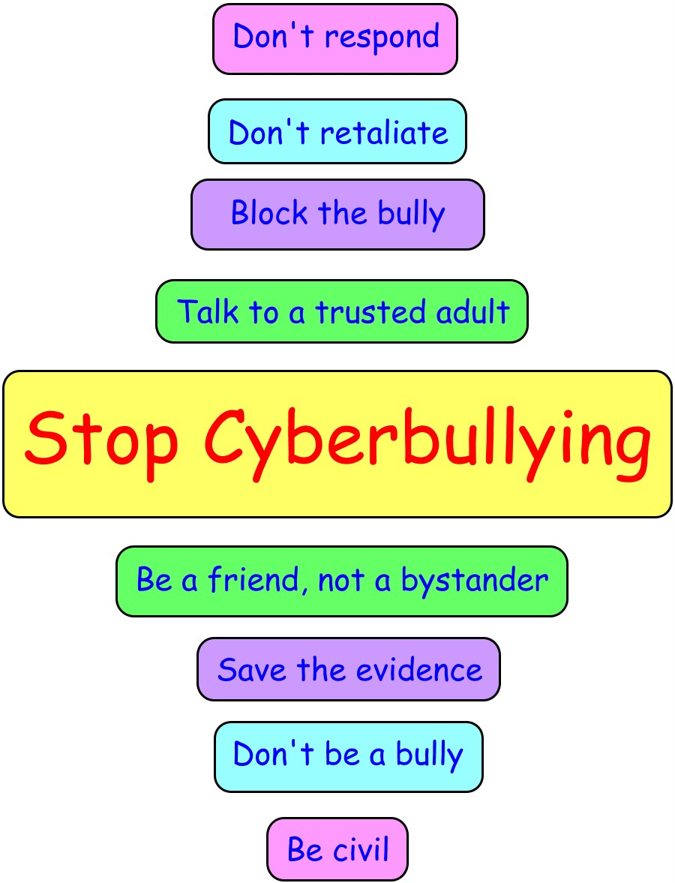
Additional Support…..
Additional Support
tacklebullying.ie/
antibullyingcentre.ie/
webwise.ie/
zeeko.ie/
ispcc.ie
childline.ie
barbados.ie

