Slide 1
Anti-Bullying and Online Safety
Primary School Programme
WORKSHOP 3:
Tackle Bullying Together!
Notes:
We ALL have a responsibility to tackle bullying - those that witness bullying are what experts refer to as Bystanders - perhaps the term Bystander might be too technical to grasp for this age-group, so instead, we will use the term ‘Onlooker’.
There are many different types of Onlookers which we will explore in this workshop.
We will also explore the Passing on of Responsibility which is explained to students using everyday examples and is rephrased as “Can’t Someone Else Do It?”

Slide 2
When Bullying Happens…
EVERYBODY is guilty of ignoring bullying at some point.
The people who see bullying happening are called Onlookers.
Who is the Onlooker in this picture?
Notes:
Slide 2 - When Bullying Happens
It is important to stress is that everyone is guilty at some point of ignoring bullying behaviour or avoiding dealing with it. This workshop seeks to change that; to show the students the importance of taking responsibility and reporting bullying in a safe and secure manner.
A Bystander is a person who sees bullying taking place. Perhaps the term ‘Bystander’ might be too technical; so instead we use the term ‘Onlooker.’
We have all been an Onlookers at some point, it is important to stress this to the students.
When you reach the final point on this slide, ask the students: “Who is the Onlooker in this picture?” (Ariel)
Then ask the following questions:
“Do you think Onlookers (Bystanders) often try to help?” (No)
And then follow this up with: “Why do Onlookers seldom offer help?”
Please provide students with Activity Sheet 3.1 entitled “Onlookers!” and let them provide the answers.
These include:
•They may be concerned for their own safety
•They don’t know what they should do to help
•They are afraid that they might be picked on
•They are friends with the kids who are bullying
•They think someone else will help
•They think they might get into trouble

Slide 3
Notes:
Slide 3 - Animated Video
This video looks at all the other characters we meet when bullying takes place. These characters are known as Onlookers, and each kid will represent a different type of Onlooker.
Buzz is the person being bullied, and Ralphie is the person who is bullying. Every other character represents a type of Onlooker.
They are:
Defender: Sergio.
Outsiders: Cathy, Leo, Suzie.
Reinforcers: Olly.
Assistants: Hugo.
Youtube video link: https://youtu.be/OVSkAF0KbCw

Slide 4
Onlookers
Leo
Suzie
Sergio
Cathy
Hugo
Olly
Notes:
Slide 4 - Onlookers
These are the different types of Onlookers:
Defenders: Comfort the person being bullied, actively tries to stop the bullying. (Sergio)
Outsiders: Witness the bullying taking place, but stays away and does not take sides. (Cathy; Suzie; Leo)
Reinforcers: Provide support to the bully. (Olly)
Assistants: Help the bully; and join in the bullying. (Hugo)
*At this point, please provide students with Activity Sheet 3.2 - where we meet some of the Onlookers from the video.
Students are asked to match the characters to the type of onlooker that they play in the video.

Slide 5
Let’s think about these kids that we met in the video.
Did they get involved?
Why do you think
that is?
Leo
Suzie
Cathy
Notes:
Slide 5 & 6 - Can’t someone else do it?”
This is where we introduce the term “Diffusion of Responsibility.” As this is quite a technical term, it needs to be phrased in a language that students can understand and relate to.
A phrase that means the same thing is “Can’t someone else do it?”
Diffusion of Responsibility is when somebody passes the buck!
Some examples might include:
You don’t bother cleaning your room because you think someone else will do it for you
You don’t bother participating in group work because someone else will instead
The aim of this slide is to emphasise that all these characters were thinking that someone else would help Buzz.
That is why they didn’t get involved.
They were therefore guilty – as we all are from time to time – of thinking: “Can’t Someone else do it?”

Slide 6
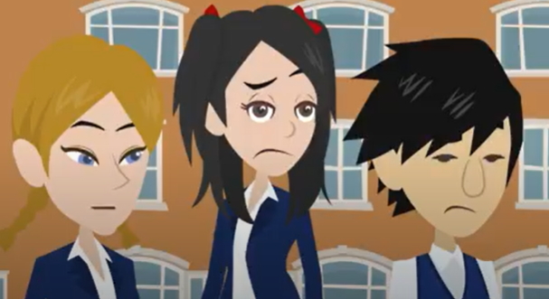
“Can’t someone else do it???”
Notes:
Slide 5 & 6 - Can’t someone else do it?”
The kids on slide 5 expected someone else to help but we have all thought this at some point (it’s important to stress this to the class).
Why do people think that someone else will stop the bullying? Because when there are more people around who could also help a person might feel that the other onlookers might be better able to intervene.
Ask the students, in a bullying situation, if they think it could be harmful to assume that someone else will help?
Diffusion of Responsibility is not unique to bullying situations; it happens all the time in our daily lives too!
Everyday examples
not putting in the same amount effort into a group project that you would to an individual piece of work or project – expect that other students will put in the work instead of you.
Leaving household tasks for your brother or sister to do such as tidying your room or doing dishes etc.
Ask the students if they can think of any more examples.

Slide 7
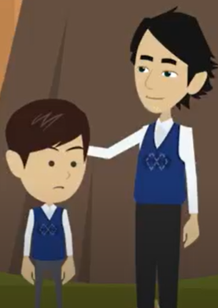
Class Discussion
Most of the kids felt like someone else would help Buzz.
If everybody thinks that someone else will help, that means it’s possible that nobody will help!
What could have happened to Buzz if Sergio didn’t take responsibility?
Notes:
Slide 7 - Class Discussion
The downside of Diffusion of Responsibility or passing on of responsibility include:
•Being unsure how to respond
•Lower sense of responsibility
•Leads to inaction.
Bullying situations can be complex, and there are many reasons why people do not wish to get involved (as we discussed). As a result Onlookers are unsure how to respond, and when this is combined with a lower sense of personal responsibility, the result is inaction, which can have serious consequences for the person who is being bullied (target).
At this point, click the slide to reveal the question: “What could have happened to Buzz if Sergio didn’t take responsibility?”
This will help start a discussion with the class on “Can’t Someone Else Do It?”.

Slide 8
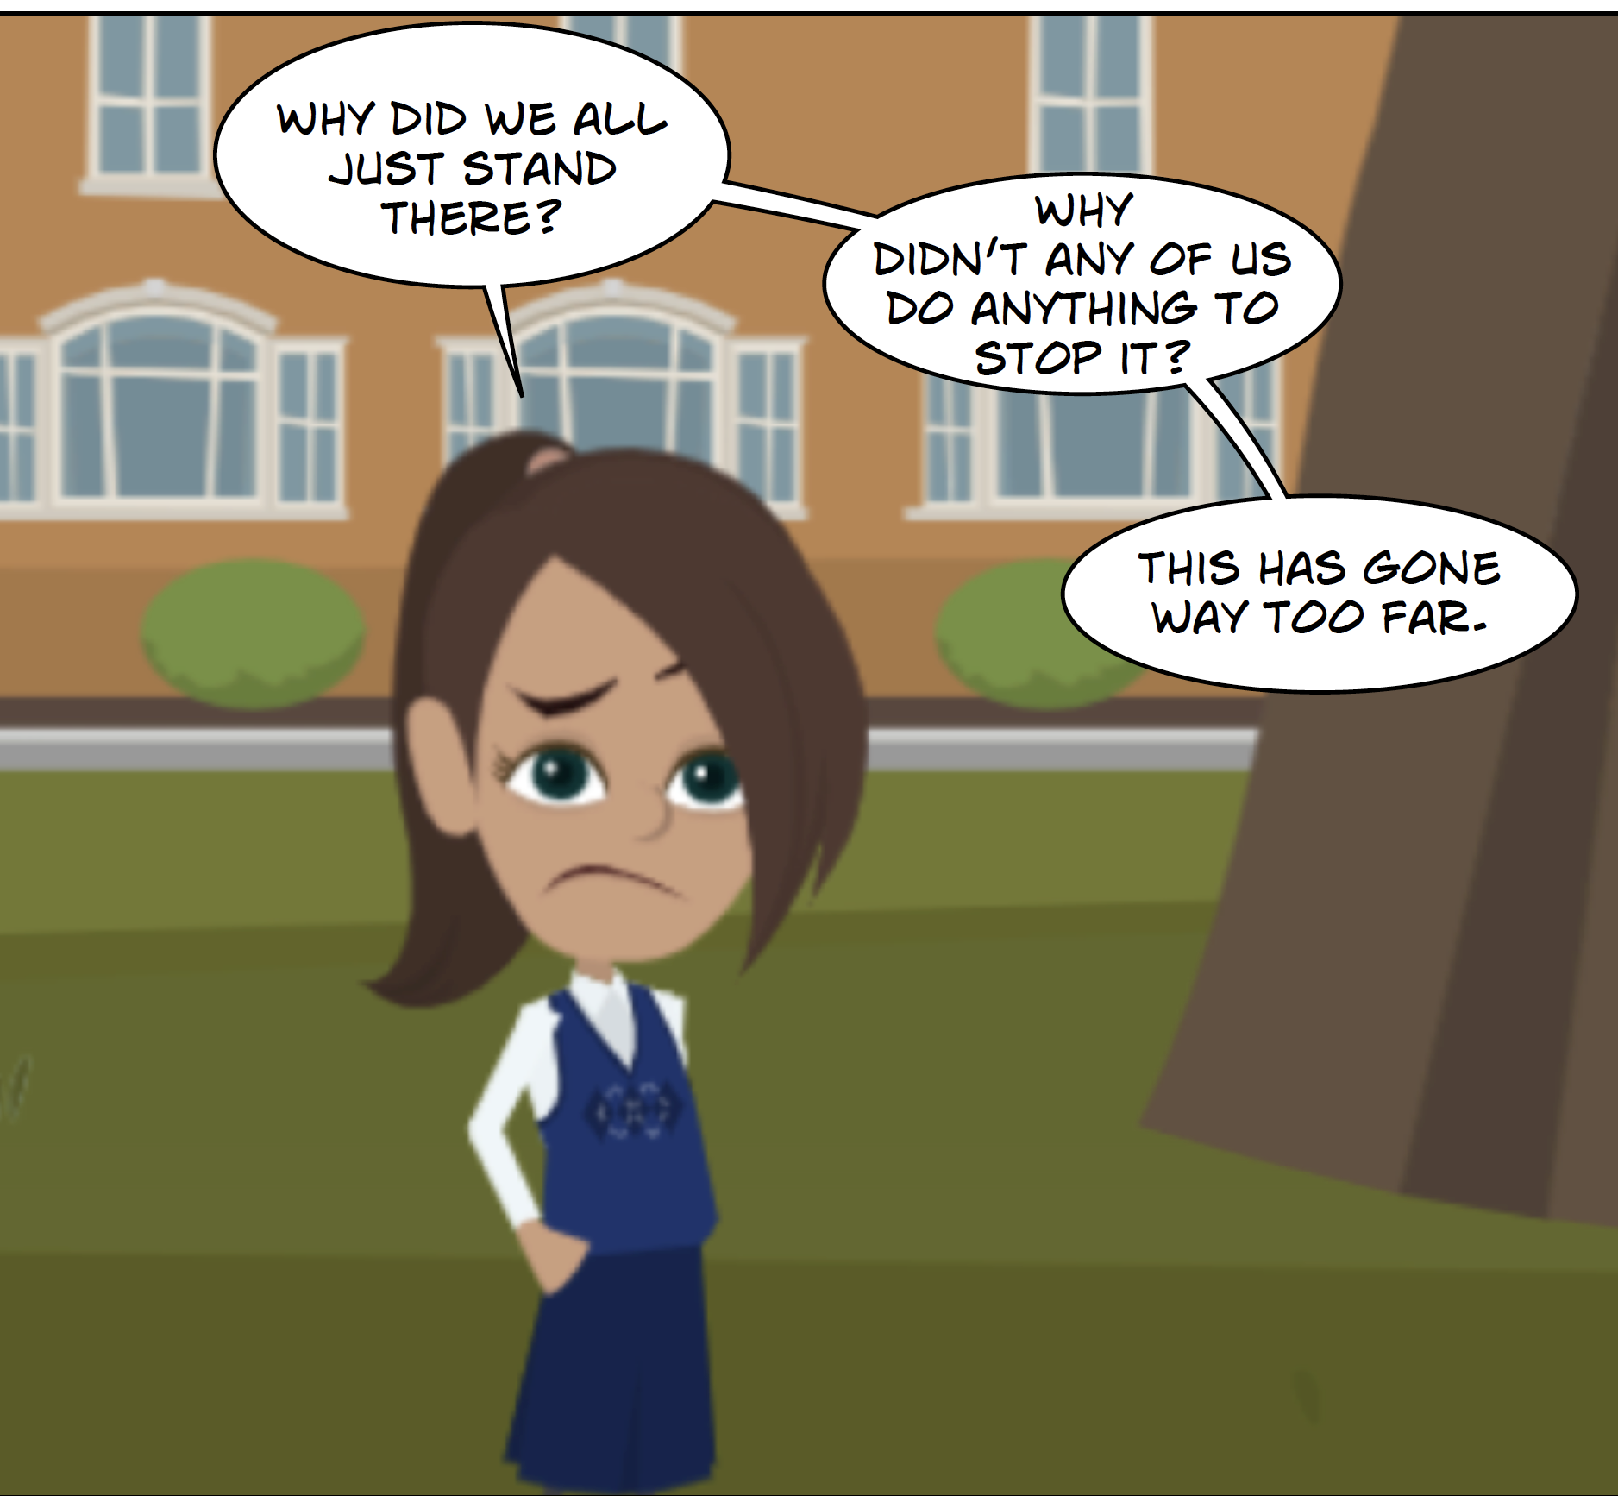
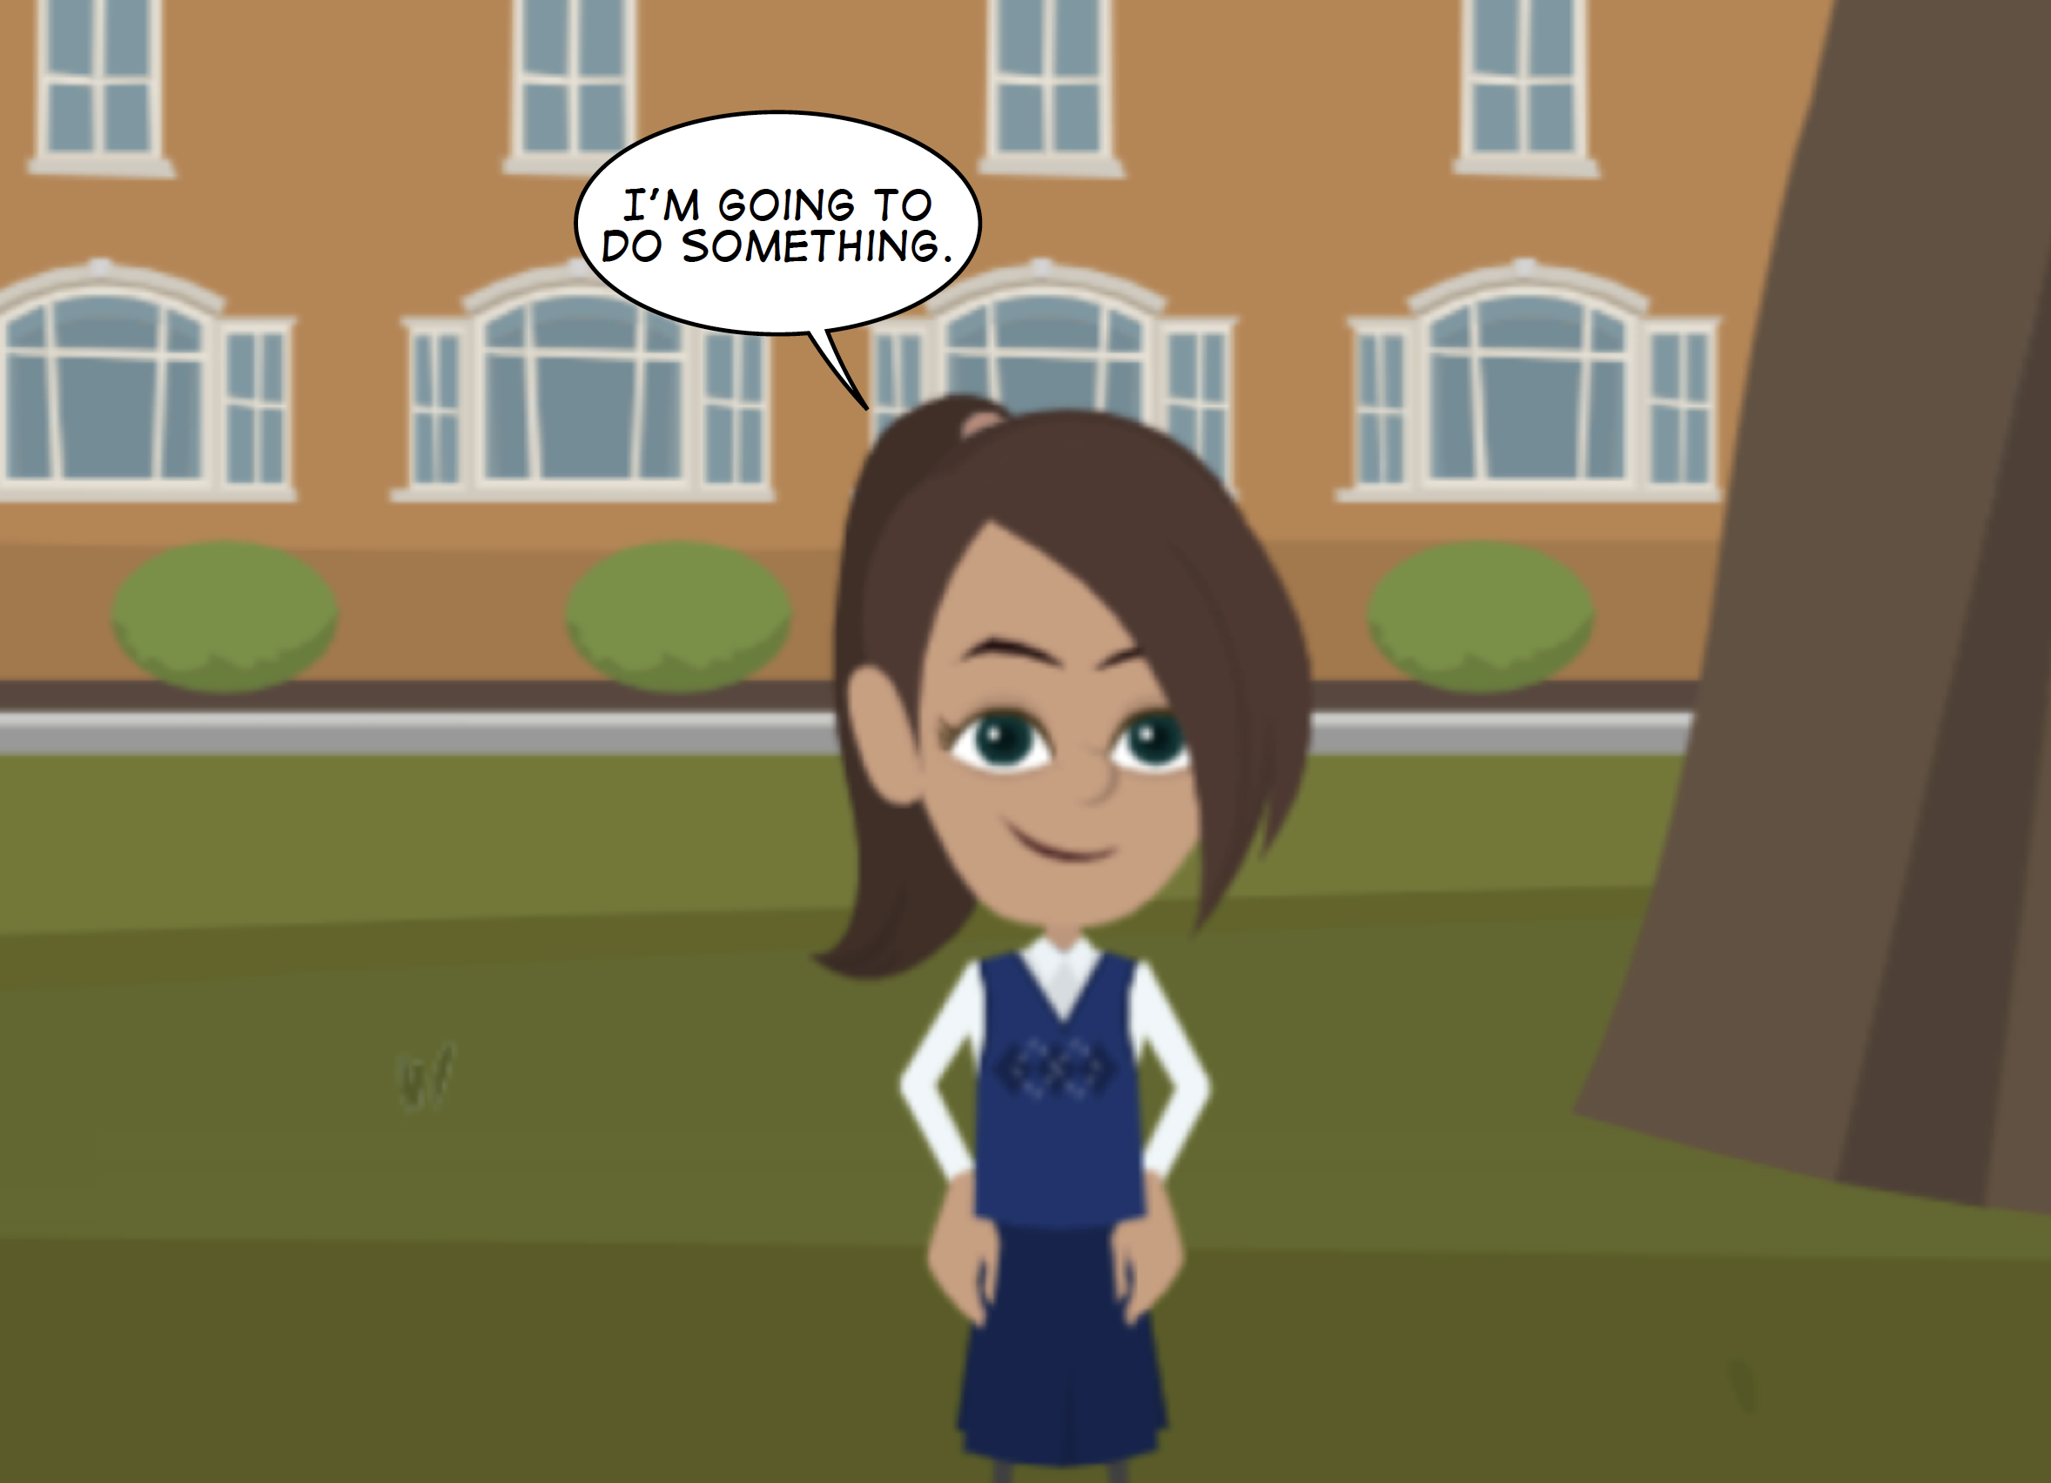
Tackle the Problem!
How do you think Ariel is feeling in Picture Two?
What do you think Ariel can do?
How do you think Ariel is feeling in Picture One?
Notes:
Slide 8 - Tackle the Problem!
Before the video ends, Ariel is feeling guilty, but as the video concludes, she resolves to do something to help Buzz.
Ask the students how Ariel feels about the bullying incident (Picture 1), and after the bullying incident (Picture 2), when she decides to act.
Think about the actions that Ariel could take. (This ties in with on of the principal aims of FUSE: namely, the student reporting bullying behaviour to their teacher, in order to decrease bullying incidents.)
Let the students provide examples of actions that Ariel could take. You could write their answers on a flip chart.
These could include:
•She might try and reach out to Buzz again, and comfort him.
•She might work with another Onlooker – one person comforts Buzz; while another tells a teacher.
•She might talk to a teacher or trusted adult.
Ariel might indeed talk to a teacher, and this is an important point to note as it leads into our next workshop: Reporting.
Remind the students that they can always talk to a teacher about bullying concerns.
Other points to consider:
•When it comes to bullying, students should NEVER feel that they can’t talk to their teacher
•Teachers have a duty of care to their students; and will always make time for them
•Indeed, when bullying occurs in a school, the teacher is the best-placed person to help and support students
(it is the teachers responsibility to work within the guidelines of the 2017 Children First National Guidelines for the Protection and Welfare of Children.)
Finally, ask the students if they think Ariel is taking responsibility? And if so, how?
When we place emphasis on the importance of responsibility, we help increase the belief in others to tackle the problem.
By doing so, you help students increase their confidence in their ability to report bullying, which can lead to a decrease in bullying incidents.

Slide 9
Things to Think About!
All the kids represent a different type of Onlooker.
Most of them thought that someone else would help Buzz.
We have all been guilty of thinking someone else can help.
The actions of Sergio not only saved Buzz, but inspired Ariel too!
Notes:
Slide 9 - Things to Think About!
Ask the students - How did the actions of Sergio inspire Ariel?
Ariel does not ignore the bullying incident or allow it to continue, she takes action as we will see next week.
Before wrapping up, please provide students with the At Home Activity Sheet, entitled “Can’t Someone Else Do it” which looks at examples of passing on responsibility.
Students can complete this activity with a parent/guardian, should they wish.

Slide 10
Help & Support
FUSE | ANTI- BULLYING & ONLINE SAFETY PROGRAMME

Slide 11
THAT’S IT!
For more information please go to www.fuse.ie

