Slide 1
Anti-Bullying and Online Safety
Primary School Programme
WORKSHOP 1:
Cyberbullying Part 1
How to be a good friend online
Notes:
Encourage as much student participation as possible - let the students offer their views and opinions, as this helps generate discussion and allows for a greater level of involvement and engagement.
The teacher will lead and direct the lesson, and close each workshop by reiterating the main points covered .

Slide 2
In this lesson we will learn…..
What is permission?
What is responsible sharing of images and videos?
What is Empathy?
How to be a good friend online
Notes:
Slide 2 - In this lesson we will learn
What is Permission?
What is responsible sharing of images and videos?
What is Empathy?
How to be a good friend online?
While the age of consent to access social media platforms is 13 years of age, Irish based research indicates that 93% of 8 to 12 year olds own their own smart device.
Research indicates that pupils between the ages of 8 to 12 years are both creators and consumers of social media platforms. A crucial aspect of this age bracket is that they are digital natives who simultaneously navigate online and offline worlds, without necessarily making distinctions between both.
In light of this, this workshop aims to educate pupils in the fundamentals of permission when creating content that includes others.
This workshop will also look at the meaning of Empathy and How to be a good friend online.

Slide 3
What is Permission?
Notes:
Slide 3 - What is Permission?
Ask the students to define, in their own words “ What is Permission?”
Permission is the act of allowing someone to do something - for example …
Person “A” should ask Person “B” for their permission to do something such as - permission to borrow their book - and Person “B” gives their permission (agrees)
Class discussion
Now ask the students to provide some everyday examples of situations where they might ask for permission.
*Encourage examples that are not solely related to parental/guardian/teacher permission

Slide 4
Things to Think About!
We should always get permission before taking a picture or recording a video of someone else
We should always get permission before sharing a picture or video of someone else
Once you share an image or video online, you lose control of the content
FUSE | ANTI- BULLYING & ONLINE SAFETY PROGRAMME
Notes:
Slide 4 - Things to think about
Discuss with your students the following:
We should always get permission before taking a picture or recording a video of someone else
We should always get permission before sharing a picture or video of someone else
Once you share an image or video online, you lose control of the content
Once you share an image/video online you lose control of the content - this means that the image or video is out in the public domain, where it can be shared, saved, downloaded, and possibly even edited.
The digital footprint will remain.
When embarrassing personal images or videos fall into the wrong hands it can lead to bullying.
Also it may appear in online search results.
In addition, knowing that an image or video has been shared without permission can lead to anxiety, stress and a loss of self-confidence for the person impacted.

Slide 5
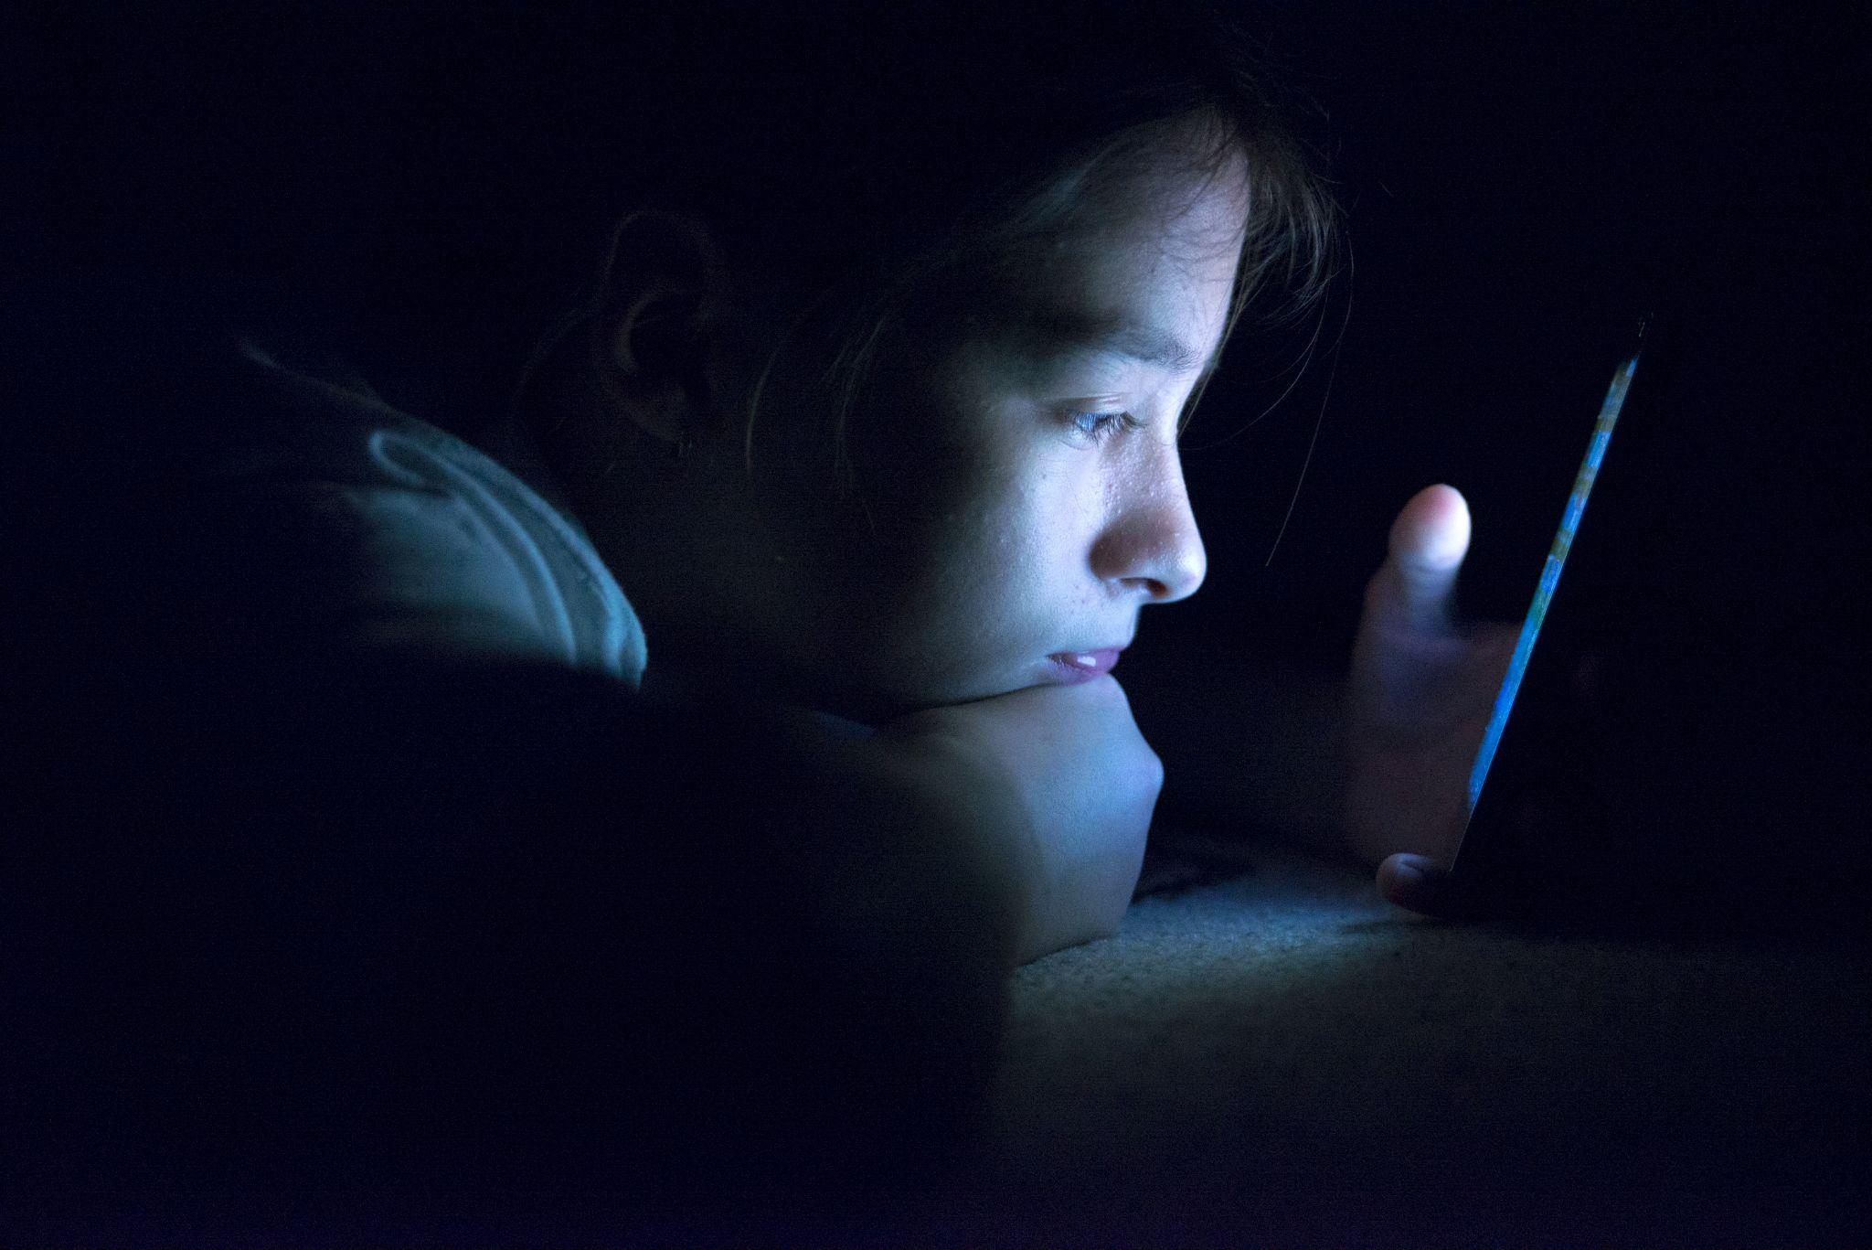
Scenario
About Maria
Notes:
Slide 5 - Scenario - About Maria
In the next slide, we will explore the topics of permission and consent by discussing a fictitious scenario..
Permission is about obtaining approval or authorisation whereas consent means coming to a mutual (voluntary) agreement where either party can say yes or no.

Slide 6
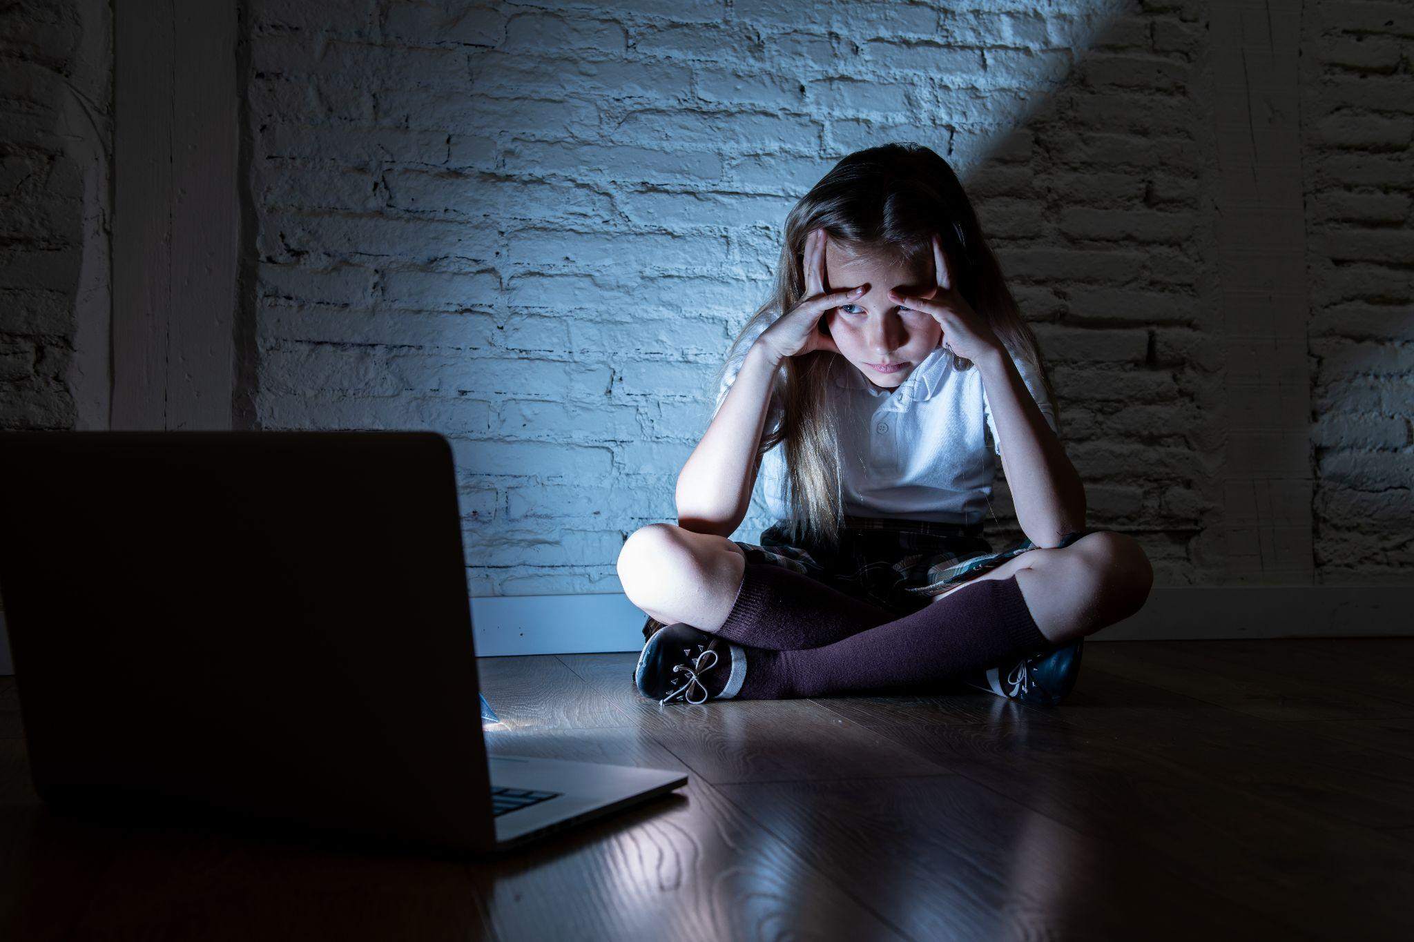
Activity 1.1
About Maria
Complete the activity and discuss your answers
FUSE | ANTI- BULLYING & ONLINE SAFETY PROGRAMME
Notes:
Slide 6 - Activity 1.1 - About Maria
Please hand out Activity Sheet 1.1
Scenario Overview
Ruby & Maria create a dance video together one afternoon.
Ruby is not happy with how she performed her dance moves and wants to spend the evening rehearsing the routine.
Both girls agree to meet the following day to film a new video.
That evening however, Maria posted the video to her social media account account tagging Ruby.
Ruby sees the video was uploaded without her permission and is unhappy but then, she sees nasty comments posted on the video - some laughing at her dance moves - e.g., " OMG, she thinks she can dance!, "This is so embarrassing - you are so bad !
This has upset Ruby even more.
Split the class into pairs
You have just read the scenario, now with your partner, answer the following questions. We will discuss the responses when completed:
What was decided between Maria and Ruby after creating the dance video?
Answer: Maria and Ruby agreed to meet the next day after rehearsing the dance and to film it again before posting the video to either of their accounts
2. What did Maria do?
Answer: Maria went ahead and posted the video to her social media account anyway without seeking Ruby’s permission.
3. What should Maria have done?
Answer: Maria should have asked Ruby in advance of posting the video for her permission to do so, which means Maria should have checked with Ruby if she would be happy for the video to be posted.
Then, after asking Ruby for her permission, Maria should have waited for Ruby to confirm her agreement (consent) to post the video before uploading it to her social media account
4. What should Maria do now?
Answer: Maria should remove the video immediately and apologise to Ruby for breaking their agreement & ignoring Ruby’s wishes.

Slide 7
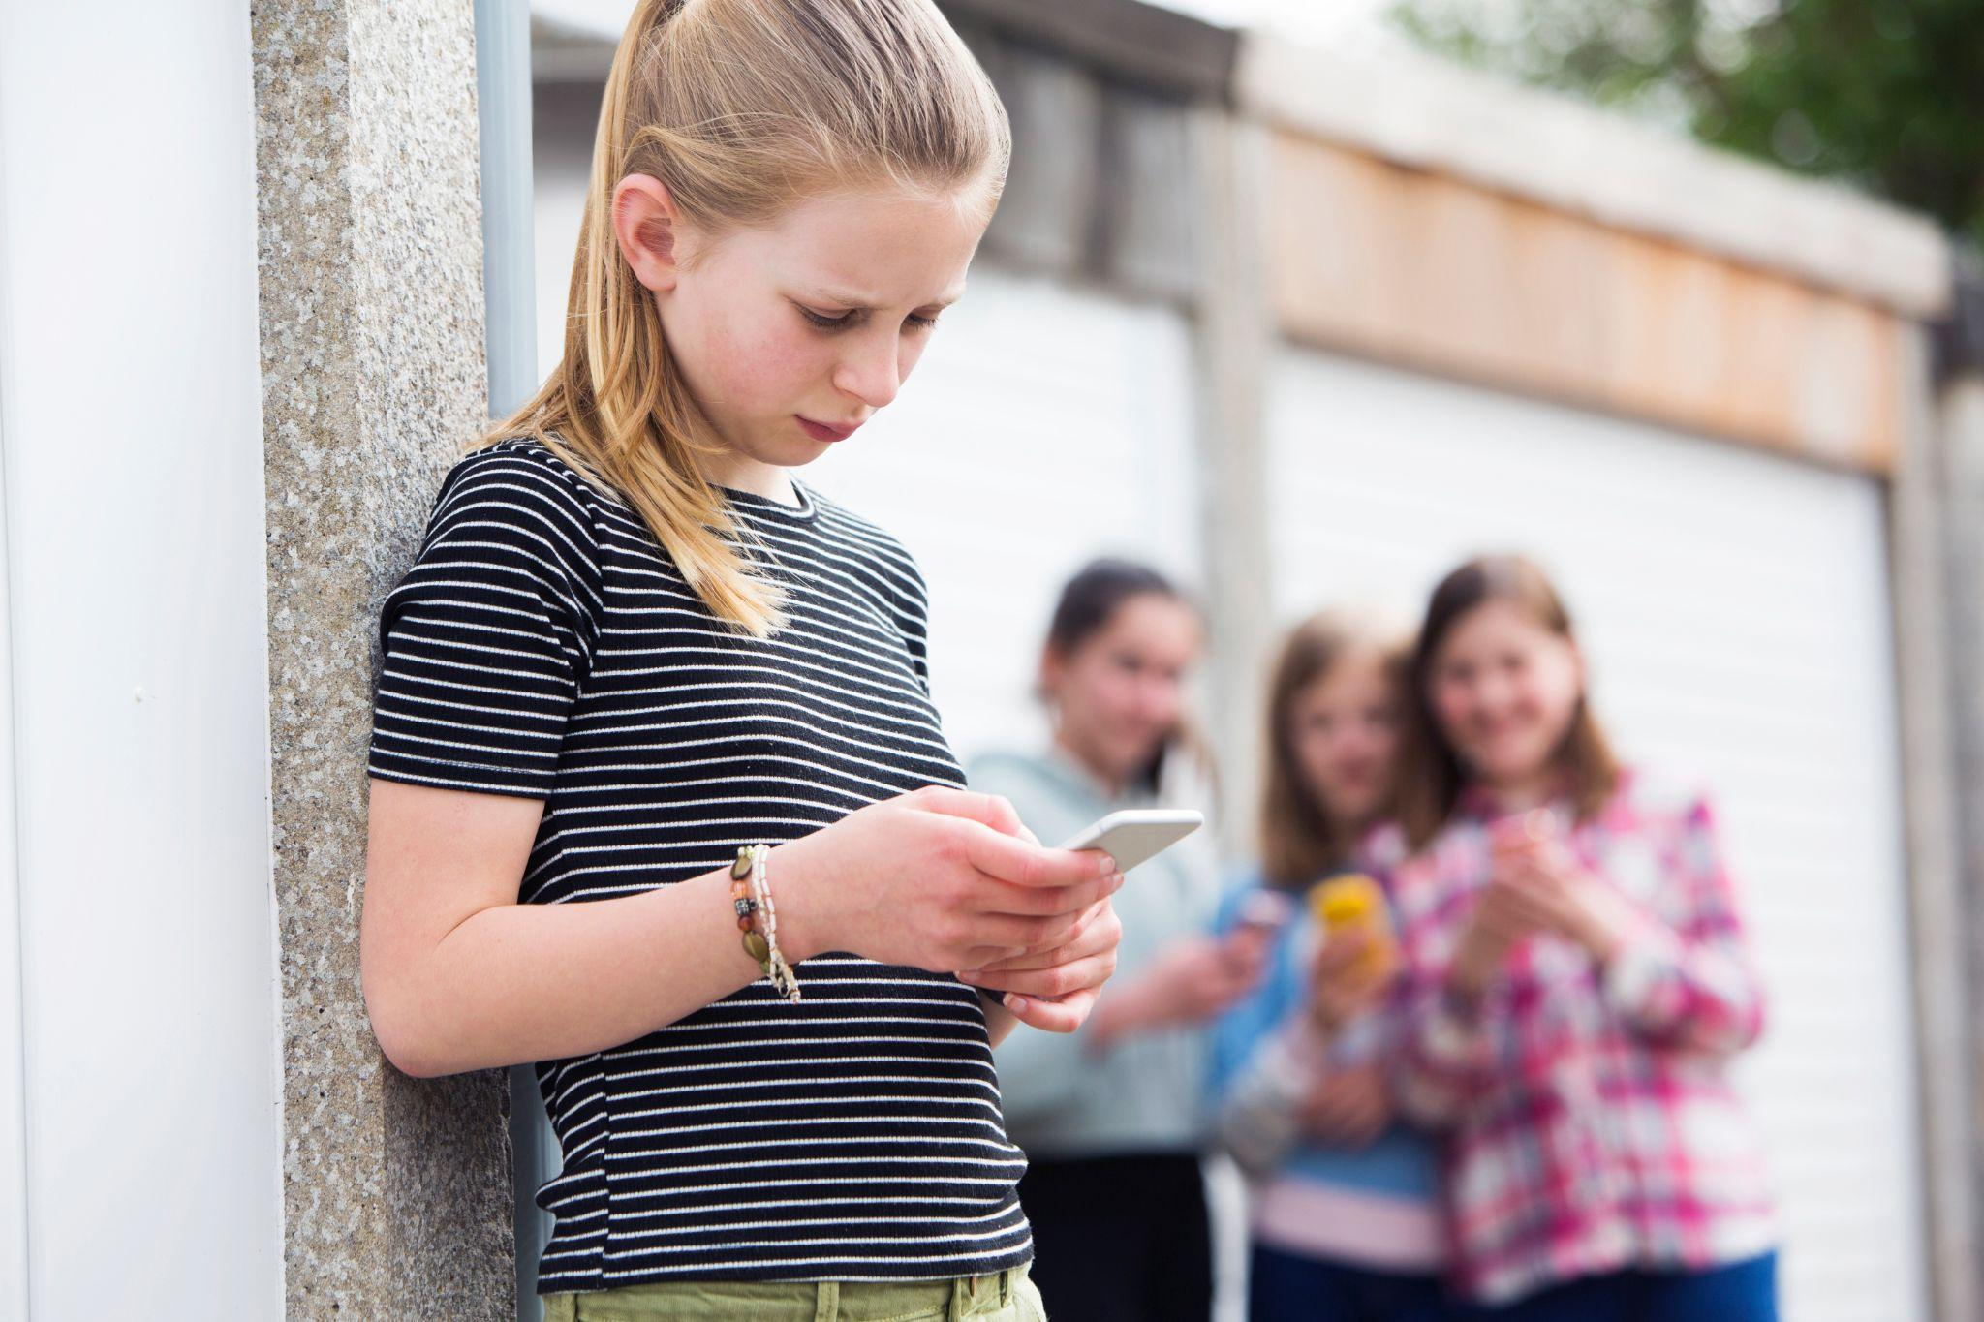
Activity 1.2
About Ruby
Complete the activity and discuss your answers
Notes:
Slide 7 - Activity 1.2 - About Ruby
Please hand out Activity Sheet 1.2
Scenario Overview
Ruby & Maria create a dance video together one afternoon.
Ruby is not happy with how she performed her moves and wants to spend the evening rehearsing the routine.
Both girls agree to meet the following day to film a new video.
That evening however, Maria posted the video on her social media account tagging Ruby.
Ruby sees the video was uploaded without her permission and is unhappy but then, she sees nasty comments posted on the video - some laughing at her dance moves - " OMG, she thinks she can dance!, "This is so embarrassing - you are so bad !
This has upset Ruby even more.
Split the class into pairs
You have just read the scenario, now, with your partner answer the following questions and we will discuss the responses in the classroom when completed:
How did Ruby feel after seeing the video?
Answer: Ruby feels upset, unhappy and let-down by her friend Maria. Ruby also feels embarrassed after seeing the video of herself posted online.
2 Why is Ruby feeling this way?
Answer: Ruby feels disappointed and let-down by her friend Maria as Maria had agreed to hold off posting the video. They had both agreed to meet the next day instead to make a new video after Ruby had an opportunity to rehearse her dance moves however Maria posted the original video anyhow, (tagging Ruby) without Ruby’s permission.
3. What could Ruby do about the situation?
Answer: There are lots of actions Ruby could take about the situation
•Ruby could ask Maria to remove the video
•She could get in contact with the social media platform and complain that the video was posted without her permission
•She could also try to untag herself (to remove the tag identifying herself in the video).
•Ruby could also tell her parents / guardians about the situation

Slide 8
Empathy is …
… the ability to sense other people’s emotions, coupled with the ability to imagine what someone else might be thinking or feeling.
“putting yourself in someone else’s shoes.”
Notes:
Slide 8 - Empathy is….
Explain to the class what empathy is.
Empathy is the ability to sense other people’s emotions, coupled with the ability to imagine what someone else might be thinking or feeling.
It is about actively listening, relating to one another, and putting yourself in someone else’s shoes.
Ask the students to think about Empathy from both Maria and Ruby’s perspective - some possible questions to consider might include….
•Did Maria show empathy towards Ruby?
•Was Maria being kind in her action and did she show respect for Ruby’s wishes?
•Did Maria consider Ruby’s feelings before posting the video?
•Did Maria actively listen to Ruby?
•Did Maria think about how her behaviour in posting the video might affect Ruby?

Slide 9
How can you be a good friend online?
Notes:
Slide 9 - How can you be a good friend online
The teacher will ask the class for their ideas on “How to be a good friend online” and complete the activity outlined in the next slide

Slide 10
Activity 1.3 (A) & (B)
How to be a Good Friend Online
Complete the activity and discuss your answers
FUSE | ANTI- BULLYING & ONLINE SAFETY PROGRAMME
Notes:
Slide 10 - Activity 1.3( A) & (B)- Class Charter - How to be a Good Friend Online
Please hand out Activity 1.3(A) and 1.3(B)
Split the class into pairs
Work with your partner on the activity
Under Activity 1.3(A) Discuss & write down ways to demonstrate how to be a good friend online
Once the activity is completed, discuss the ideas put forward by the students amongst the whole class.
The teacher will write down the ideas put forward on a flipchart / whiteboard.
The ideas put forward will then form the basis of a Class Charter on how to be a good friend online.

Slide 11
How can you be a good friend online?
If you have said something mean about someone online, say or do something kind instead to show that you value their friendship
If you have excluded someone online - find a way to include them by adding them to the game or to the group
If you shared something that you shouldn’t have - take it down asap - if you do not know how to, talk to an adult for help and guidance
Always feel confident to ask an adult for help and encourage your friends to do the same if someone or something upsets you/them online
Always think BEFORE you post online and consider the impact and consequences of the content you share whether a joke, photo, video or message
Notes:
Slide 11 - Activity 1.3(B) - How can you be a good friend online
From the full list of ideas put forward, the class will decide which ideas they wish to choose to create and inform their Class Charter on “ How to be a good friend online”.
They will then update the Activity Sheet 1.3(B) entitled “Class Charter-How to be a Good Friend Online “ with the agreed / chosen ideas
The students can make posters of the “How to be a Good Friend Online Class Charter” for display in the class / around the school.
Some ideas might include:
If you have said something mean about someone online, say or do something kind instead to show that you value their friendship
If you have excluded someone online - find a way to include them by adding them to the game or to the group
If you shared something that you shouldn’t have - take it down asap - if you do not know how to, talk to an adult for help and guidance
Always feel confident to ask an adult for help and encourage your friends to do the same if someone or something upsets you/them online
Always think BEFORE you post online and consider the impact and consequences of the content you share whether a joke, photo, video or message

Slide 12
Remember to always...
Think about your actions!
How might my action impact the other person?
Ask for permission!
BEFORE taking or sharing a picture, image or video of someone else
Consider the consequences !
Once you post you lose control of the content
Self-reflect !
Am I being empathetic towards the other person?
Ask yourself !
Am I being a good friend online?
Notes:
Slide 12 – Remember to always…
This slide acts as a recap of the workshop and aims to provide the students with a consolidated overview of the topics discussed together in class.
Ask for permission - BEFORE taking or sharing a picture, image or video of someone else
Consider the consequences - Once you post you lost control of the content
Think about your actions - How might my action impact the other person
Self-reflect - Am I being empathetic towards the other person
Ask yourself - Am I being a good friend online?
It is important to self-reflect on the following questions before you post something online about someone else:
Will I feel good or different about it later?
Why am I posting?
Am I being kind?
Do I have permission?
Would I be happy if this happened to me?
It is also important to remember however that not all disagreements or arguments constitute actual bullying or cyberbullying behaviour.
Conflict happens in all relationships. We all have arguments with people from time to time.
Bullying is different to having an argument or a fight.
Conflict may progress / escalate to bullying if we are trying to force someone to agree with us or if we are repeatedly picking an argument or targeting someone, therefore, it is equally important to learn how to deal with conflict which we will explore in our next workshop.

Slide 13
Help & Support
FUSE | ANTI- BULLYING & ONLINE SAFETY PROGRAMME

Slide 14
THANK YOU
For more information, please go to www.antibullyingcentre.ie/fuse

