Slide 1
Anti-Bullying and Online Safety
Post Primary School Programme
WORKSHOP 13:
A World Made of Stories
Notes:
Students are divided into groups of 3 or 4. Each group has to choose a team name and a team leader, who will be responsible for liaising with the teacher and members of other groups during practical activities.
They will be provided with a white sheet and pens.

Slide 2
WHAT HAVE WE
LEARNED SO FAR?
Notes:
The teacher should review what they learned in the previous lesson and then proceed.

Slide 3
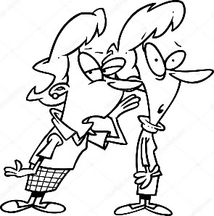
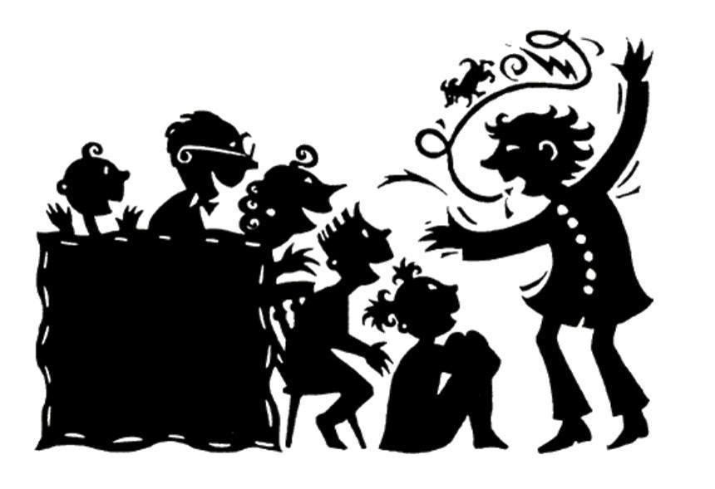
What comes to your mind when you think about STORIES?
Notes:
Activity 13.1 and class discussion
Students are divided into groups of 3 or 4. Each group has to choose a name and a team leader, who will be responsible for liaising with the teacher and members of other groups during practical activities. They will be provided with a white sheet and pens.
Brainstorm (10 min)
Students will be asked to brainstorm and write down as many words/expressions that come to mind when they think about stories.
The teacher will be facilitating the discussion by suggesting some ideas/concepts, such as the ones below.
Real / Fictional Stories, Medium, Format, Representation, Facts, Bias, Editing, Imagination, Creativity, Language, Evidence, Opinion, Interpretation
After the brainstorm, the teacher asks the groups to read out some of the ideas and explain them. The goal here is for students to reflect on the many elements of a story.
It is a warm-up activity in preparation for the next task.

Slide 4
Playing with cards
Editing a scene of the film “The Birds”, by Alfred Hitchcock
Notes:
Activity 13.2
The teacher will then hand out 30 cards that contain clips of a scene from the film ‘The birds’. All groups will have the same set of the cards. Students will be asked to look at the cards carefully and try to figure out what is the best sequence for the scene. They will have to arrange the cards in this sequence using a board or a desk. This should take around 15-20 minutes. After that, they will have to write down the story of the scene (another 10 minutes for that – it is a very short story). While students are writing the stories, the teacher will go around the class taking pictures of the sequence organized by each group. The pictures will be displayed on the screen.
Alternatively, the teacher can display the sheets on the board in sequence once the students complete the story.
The teacher will then display the first sequence on the screen / board and ask students to read out the story. The same will be done with the groups, always showing the sequence on the screen and asking students to tell the story (another 10 minutes).
Some questions for guidance:
What did you like/did not like about creating the sequence? What was the most difficult part?
Tell me why you think this is the best way to tell the story.
If you had the chance to start again, would you tell the story in a different way? Why?
Do you think the different sequences express different ideas/meanings, or do you think they all convey identical ideas?
If there is sufficient time, the teacher can play the real scene from the movie – students are usually very curious about whether or not they got the sequence right. It is available on YouTube - https://www.youtube.com/watch?v=5-HYj5cLfEI
Next, the teacher will say the following: “You guys had the same 30 cards from the same scene. Still, all stories came out slightly different. Why is that so?”
The main point here is to make students understand that there are many different ways of telling the same story, and that everything is dependent on the way we EDIT the story. Editing has to do with choices, with the way we select the words/images, the way we express ideas from a certain point of view. It has to do with the parts we want to include and the ones we choose to leave out. All the editing resources affect the way the story will be told and, as a consequence, will affect how the story is UNDERSTOOD by the audience.

Slide 5
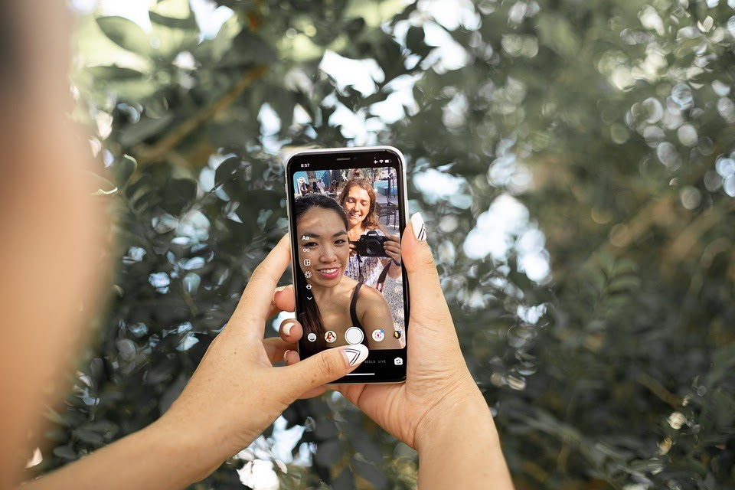
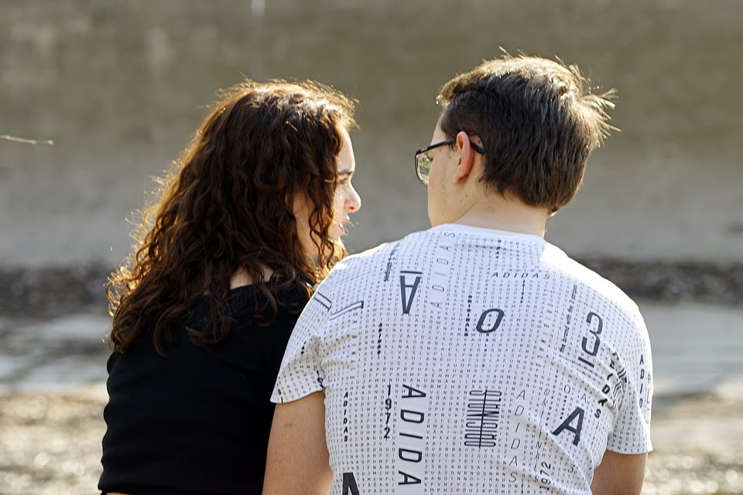
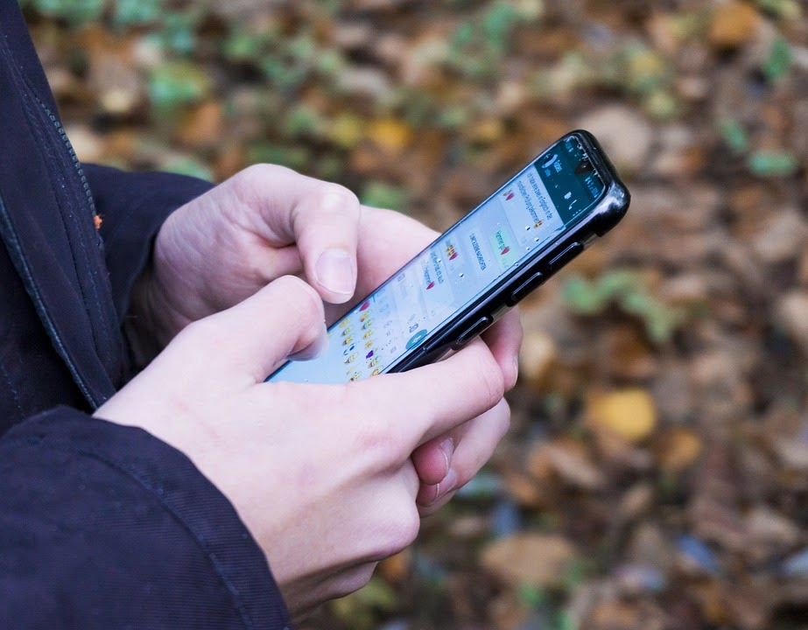
We are editing all the time
We are all editing all the time.
Telling stories
Social media pictures
Snapchats
Every time we choose the words, we select emojis, we crop a picture - we are editing the information in order to create a specific meaning that we want to convey.
Notes:
Teacher will say that we perform editing all the time – when we are telling a story to a friend, chatting on social media, posting a picture online, sending messages through Snapchat or WhatsApp etc. Every time we choose the words, we select the emojis, we crop a picture etc. we are editing the information in order to create a specific meaning that we want to convey.

Slide 6
Bad Editing
Notes:
The teacher will then explain that bad editing can have harmful effects on people. The teacher will first show a video from the Simpsons where Homer gets into trouble because of bad editing. The teacher will then move to the next slide, a more serious one, where the picture of O.J. Simpson was edited in two different ways by the Times and Newsweek magazines.
https://www.youtube.com/watch?v=SqDP8SnPVA0

Slide 7
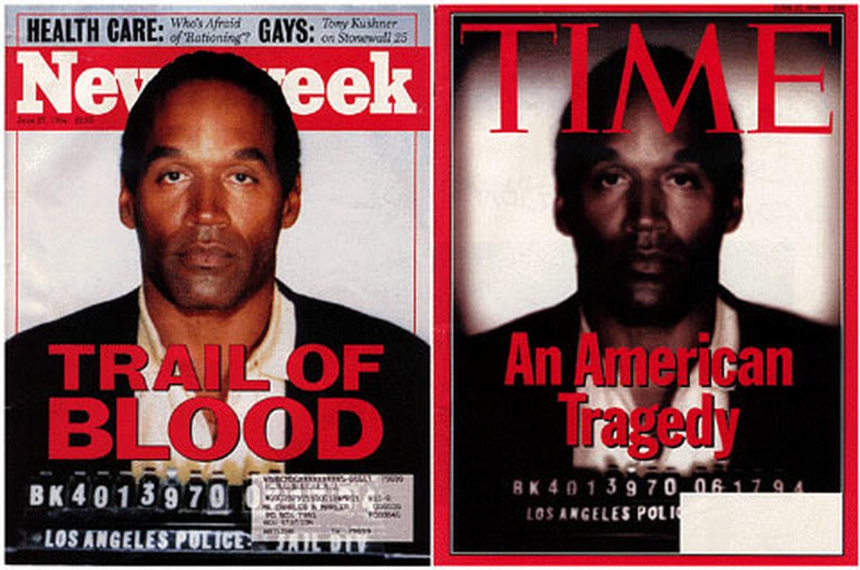
Bad Editing
Notes:
This next slide, is a more serious one, where the picture of O.J. Simpson was edited in two different ways by the Times and Newsweek magazines. Teacher will ask students to quickly analyse both covers and say what the main difference between them is. The Times’ cover is a lot darker, and for that reason the magazine was accused of racism because O.J’s skin was made darker.
Source: https://medium.com/georgexlinblog/photography-why-it-isnt-all-about-photoshop-711b99b01de9

Slide 8
Bad Editing
Bad editing can have harmful effects on people
Homer gets in trouble because of bad editing
Times and Newsweek magazines:
The Times’ cover is a lot darker and for that reason the magazine was accused of racism because O.J’s skin was made darker.

Slide 9
Good editing
Your choices make the difference
Words and images can harm
Choose wisely how you are going to tell a story and protect yourself and the people around you.
Notes:
The teacher will conclude the session by saying that bullying situations may start from a story that was not properly edited and told. The way we choose to tell a story can have serious consequences for other people.
For this reason, we should always choose wisely how we tell a story, in order to protect ourselves and the people involved.

Slide 10
Things to consider…
All stories are constructed and are never the pure representation of reality
Everyone experiences the same story in a different way
How we tell stories can affect the audience
Notes:
This slide acts as a recap of the workshop and provides the students with a consolidated overview of all the learnings to-date

Slide 11
Reflection activity
In this lesson I learned
1
2
3
4
5
Notes:
The importance of this workshop is to in still the idea of stories and how they can differentiate with other people’s stories.
Students need to consider what they have learned during the workshop.

Slide 12
Help & Support
FUSE | ANTI- BULLYING & ONLINE SAFETY PROGRAMME

Slide 13
THANK YOU
For more information, please go to www.antibullyingcentre.ie/fuse

