Slide 1
Anti-Bullying and Online Safety
Post Primary School Programme
WORKSHOP 14:
Do you trust the information you find online?
Notes:
Students are divided into groups of 3 or 4. Each group will choose a team name and a team lead, who will be responsible for liaising with the teacher and members of other groups during practical activities.
They will be provided with a white sheet and pens.

Slide 2
WHAT HAVE WE
LEARNED SO FAR
Notes:
The teacher should recap on the learning outcomes from the previous workshop and then proceed.

Slide 3
Information Literacy
What is the difference between information and knowledge?
What is the difference between facts and Opinion?
Notes:
Activity 14.1 and Discussion
Students will be asked to discuss in their groups the main differences between information and knowledge and between fact and opinion.
The idea here is to prompt students to think about the difference between the information they encounter in their everyday lives, especially digital information, and the
actual interpretation, understanding and use of that information, which could be described as knowledge.
They will come up with some ideas and write them down on the sheet. The teacher then asks the groups to read out some of these ideas and put them up on a
white board.

Slide 4
Does this symbol have any meaning?
トイレ
Notes:
The teacher will ask students if what they see on the screen is information. S/he will then ask if the symbols have any meaning, if they mean something.

Slide 5
トイレ
Toilet
Notes:
The teacher will then disclose the meaning (TOILET IN JAPANESE), and then explain that it is information because it has meaning, which is toilet, even though students didn’t know what it means. A word in Japanese is information, but if you don’t know speak the language you will not be able to understand it.
So, from the communication point of view, information is anything that has meaning.
However, in order to turn this information into knowledge, it is necessary to understand this information – know what it means.

Slide 6
Is this information? If so, why?
Notes:
The teacher will ask students if what they see on the screen is information. Everyone will probably say yes, and the teacher will ask why that is information. The teacher should expect them to say that it is because
it has meaning. The teacher will then ask whether they think that is also knowledge, and students will probably say yes, as everyone knows that the sign means ladies/gents toilet.

Slide 7
Information and Context
Notes:
Activity 14.2 (a)
The teacher will ask students if they know what the picture on the screen is. The right answer is SKULL WITH CROSSED BONES.
Some students will say “death, “danger”, and then the teacher will say that the question that is being asked is “what it is” and not “What it means”.
Finally, the teacher will then ask what it means.
Answers may include, for instance, death, pirate, danger etc.

Slide 8
Notes:
The teacher will then reveal the second picture – a bottle with the skull – and ask students what that means. They will say that it means the bottle contains something dangerous, maybe a poison or something like that.

Slide 9
Notes:
Teacher will then reveal the third picture – red circle – and ask students what they see on the screen.
Answers will be, for instance, red circle, red dot etc. The teacher will then ask what it means.
Answers will be Japan flag, record button etc.,

Slide 10
Notes:
The teacher will then reveal the fourth picture – traffic lights – and ask students what that means. They will say the red dot in this case means STOP.

Slide 11
Information and Context
Information depends on the context where it is used.
Even though you knew what a skull with crossed bones and a red dot are, the true meaning was revealed when the information was put into a specific context.
So the INTERPRETATION of information is also dependent on the context, as meanings can vary according to different contexts.
Notes:
The teacher will then explain that information also depends on the context in which it is used. Even though students knew what a skull with crossed bones and a red dot represents, the true meaning was
revealed when the information was put into a specific context. So the INTERPRETATION of information is also dependent on the context, as meanings can vary according to different contexts.

Slide 12
Conclusion: Information, Context and Knowledge
Information is any data that you encounter. Anything that has meaning.
Knowledge is information that is correctly interpreted, understood and incorporated into your knowledge repertoire.
Notes:
This slide concludes the first part. Teachers can use some of the notes on the white board to engage students in the wrap up.

Slide 13
Information Literacy
What’s the difference between:
Controversial Information
False information
Bullshit information (careless information)
Notes:
Teacher will tell students that there are many different types of information.
Three such types are displayed
on the screen:
» Controversial Information
» False information
» Bullshit information (careless information)
The teacher will ask students to discuss in their groups and come up with definitions for these three types of information.
The teacher asks the groups to read out some of their ideas and put them up on a white board.
Usually, students know how to explain what controversial and false information is, but they struggle to guess what bullshit information is – the term bullshit information can be replaced by careless
information if the teacher finds it more appropriate.

Slide 14
Information Literacy
Controversial Information
Information that is debatable, that is subject to dispute and disagreement.
False information
Information that is not based on facts or evidence; it is simply not true-
Bullshit information
Information that is used without proper care or consideration. The bullshitter doesn't care if what they say is true or false, if it is accurate or inaccurate; the important thing is to participate in the conversation and, in some cases, persuade the listener.
Notes:
» Controversial Information: information that is debatable, that is subject to dispute and disagreement.
» False information: information that is not based on facts or evidence; it is simply not true.
» Bullshit information: information that is used without proper care or consideration.
The bullshitter doesn’t care if what they say is true or false, if it is accurate or inaccurate; the important thing for the bullshitter is to participate in the conversation and, in some cases, persuade the listener.

Slide 15
Are you a Bullshitter?!?!?!
Notes:
The teacher will ask students if they are bullshitters?
The first reaction is usually to say no, but at this point it is important that the teacher explains that everyone is or has been a bullshitter at some point.
People tend to talk about things that they don’t understand all the time. In some cases, people do that for bad reasons, for example when they want to achieve some goal or persuade someone to do what
they want. However, most of the time they don’t do it for bad reasons or to cause harm to anyone; they do so for many different reasons such as: they want to take part in a conversation; they want to feel part of a
group; they do not want others to think they are stupid; they want to be funny or become popular etc.
Here the teacher can use some examples from everyday life to make the conversation more engaging, maybe using some stories that took place in the school.
The important point here is to explain to students that in some situations, even if we don’t want to cause any harm to anyone, that if we engage in bullshit conversations without being careful with the quality of
the information we use, we may cause harm to people, communities and organizations. If we spread a story with inaccurate, misleading or even false information (even without intention), this can have very serious
consequences.
Note for the following slides:
In the context of bullying and cyberbullying, using information in an insensitive or careless manner can start a process that may lead to someone being the
subject of bullying.

Slide 16
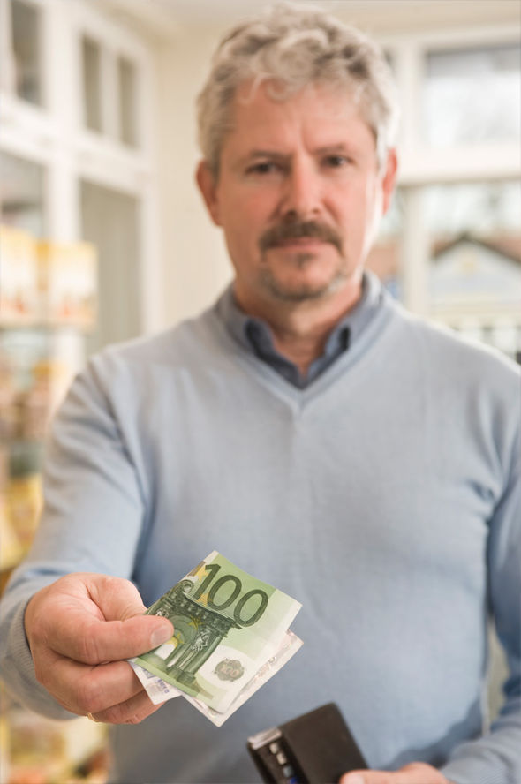
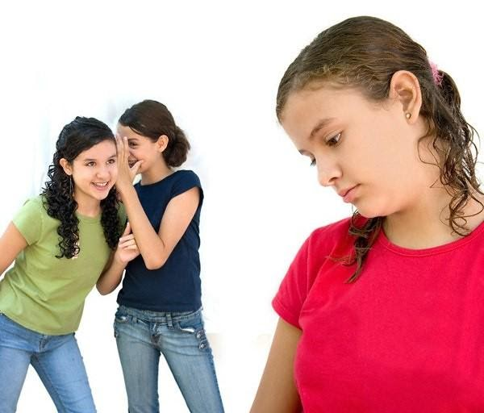
Notes:
Activity 14.2 (b)
On the screen there are 3 pictures of some random situations involving young people at school. Each group will choose a picture and write down responses to the following questions:
What do you see on the picture?
What are the possible meanings associated with what you are seeing?
How would you text what you are seeing to someone else? (3 options)
Some possible answers from students:
PICTURE 1 - A boy talking to a girl very closely. This can suggest that he is hitting on her – or the opposite. It can also suggest that he is telling her a secret. Or that he is getting closer to check something on her face.
PICTURE 2 - A boy giving money to another boy – the one receiving is turning his head and looking over his own shoulder. This can suggest that they are doing something wrong because the way the boy is moving his head, as if he is checking if somebody is watching. It can also suggest that somebody called him and then he just turned his head. Or the first boy asked him where is the ATM and he was looking at its direction to tell him.
PICTURE 3 – Two girls are laughing at the background and a third one is looking down very serious on the foreground. This can suggest that the two girls are gossiping or making fun of the third girl It can also be that they are talking about something else, and the third girls is just looking down because she is reading something on her phone.
After students complete this activity, the teacher will ask each group to read out the responses and compare them. The idea here is to get students to reflect on the difference between what they
see (information) and the interpretation and understanding of what they see (knowledge), and then check how they would react to it. Because the image allows for more than one interpretation, the
teacher will then ask if any of the interpretations can cause harm to the people involved, which could lead to this person being bullied depending on the kind of message they send through their phones.
The teacher then facilitates a discussion about the best practices involved in the use of information.

Slide 17
Three weapons against
FACT CHECKING
MULTIPLE, DIVERSE AND RELIABLE SOURCES
CHALLENGE ONE’S OWN CONVICTIONS, OPINIONS AND BELIEFS
Notes:
The teacher will show the 3 safeguards against bullshit information.
It is important to check the facts, rely on more than one source for obtaining information, and challenge one’s own convictions, opinions and beliefs. The teacher will explain that this is valid for both offline and online information. The more we care about the quality of information we consume and the way we interpret it, the more we can avoid misleading messages that can cause harm to people.

Slide 18
Things to consider…
The difference between information and knowledge and between facts
and opinions
The better the
quality of the information you
consume, the better able you will
be to make sense of the world
around you
Different types of information can affect communication
Improving your communication skills can help you being understood better and avoid being deceived by false/misleading information
Notes:
This slide acts as a recap of the workshop and provides the students with a consolidated overview of all the learnings to-date.

Slide 19
Reflection activity
In this lesson I learned
1
2
3
4
5
Notes:
The importance of this module is to instill the idea of reliable information that students may come across.
Students need to consider what they have learned during the workshop.

Slide 20
Help & Support

Slide 21
THANK YOU
For more information, please go to www.antibullyingcentre.ie/fuse

