Slide 1
Anti-Bullying and Online Safety
Primary School Programme
WORKSHOP 3:
Empathy and Relationships

Slide 2
WHAT HAVE WE LEARNED SO FAR?
FUSE | ANTI- BULLYING & ONLINE SAFETY PROGRAMME
Notes:
Teacher should recap on the learning outcomes from the previous workshop and then proceed.

Slide 3
Notes:
Empathy video.
youtube link or website https://youtu.be/1Evwgu369Jw
In this slide students will watch a video that explains what empathy is.
“Empathy”, created by Brené Brown

Slide 4
WHAT IS EMPATHY?
FUSE | ANTI- BULLYING & ONLINE SAFETY PROGRAMME
Notes:
Activity 3.1
This is an individual activity.
This activity is about how to express empathy.
Students are provided with some examples of people who express empathy and people who do not express empathy.
Students should read each sentence carefully and categorize them into expressing and not expressing empathy.
After the activity, students should discuss their responses in the class.
Some ways of expressing empathy are:
» Being Non judgmental
» Be aware of/sensitive to people’s feelings
» Eye contact/positive body language/gestures
» Open questions
» Relating (sharing experiences)
» You are OK
» Show you are LISTENING
» Acknowledging

Slide 5
What is empathy?
Empathy can be defined both as (a) someone's ability to experience someone else's feelings, emotions and perspectives, and (b) their ability to understand another's emotions and experiences (Jolliffe & Farrington, 2006).
Notes:
Empathy can be defined both as (a) someone's ability to experience someone else's feelings, emotions and perspectives, and (b) their ability to understand another's emotions and experiences (Jolliffe & Farrington, 2006).
Being sensitive to, and vicariously experiencing the feelings, thoughts, and experiences of another, without having these feelings, thoughts, and experiences communicated in an objectively explicit manner.
Empathy is often seen as having two components:
Cognitive Empathy - the ability to understand and identify another person’s thoughts, feelings, and perspective, sometimes referred to as ‘putting yourself in someone else’s shoes’.
Emotional or Affective Empathy – the ability to share another person’s feelings or feel what they feel.
Many theorists add a third component: the decision to take empathic action. Activated Social Empathy is empathy that is active rather than passive or static. It generates a range of positive social impacts from social action to civic participation.
Why is social empathy important?
At the most fundamental level, having and demonstrating empathy forms the foundations of positive social understanding amongst human beings. Social empathy in young people matters because of its capacity to improve interpersonal relationships, to foster social connectedness and promote civic engagement. Childhood and adolescence has been identified as a crucial period for empathy development.
Research with young people has demonstrated an association between higher levels of empathy and a range of benefits including
Greater social competence
Better quality peer relationships
Increased conflict resolution skills
Lower aggression
Less prejudice
Greater academic achievement.
Cultivating empathy in young people therefore offers a pathway to the development of prosocial helping behaviours and social connection; to a set of values that include social responsibility; and to social action and civic engagement.
In short, activating social empathy forms a crucial component of children and young people’s development and has potentially radical implications for the future of society.

Slide 6
Notes:
VIDEO OF SHANE https://youtu.be/acyRVUpWk0g
In this slide students will watch the video about
Shane’s story.

Slide 7
Notes:
VIDEO OF LAURA Play button bottom left hand corner - https://youtu.be/HUECpazmZZM
In this slide students will watch the video about Laura’s
story.

Slide 8
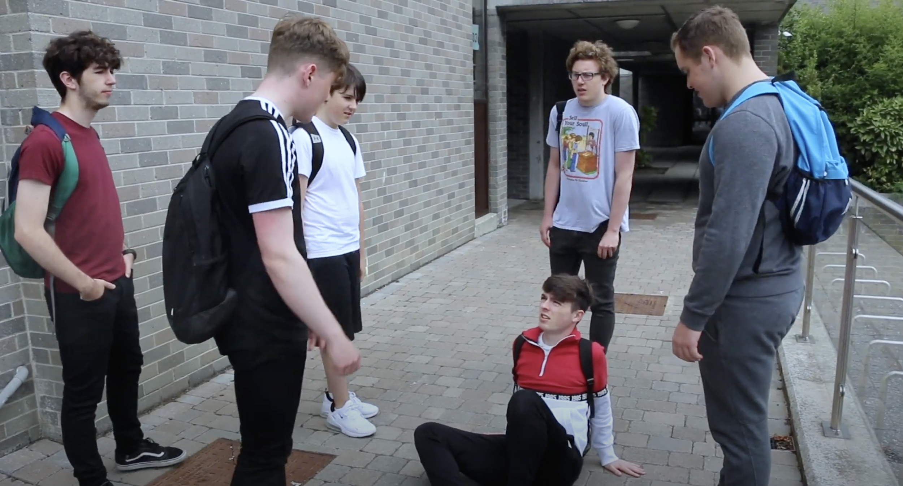
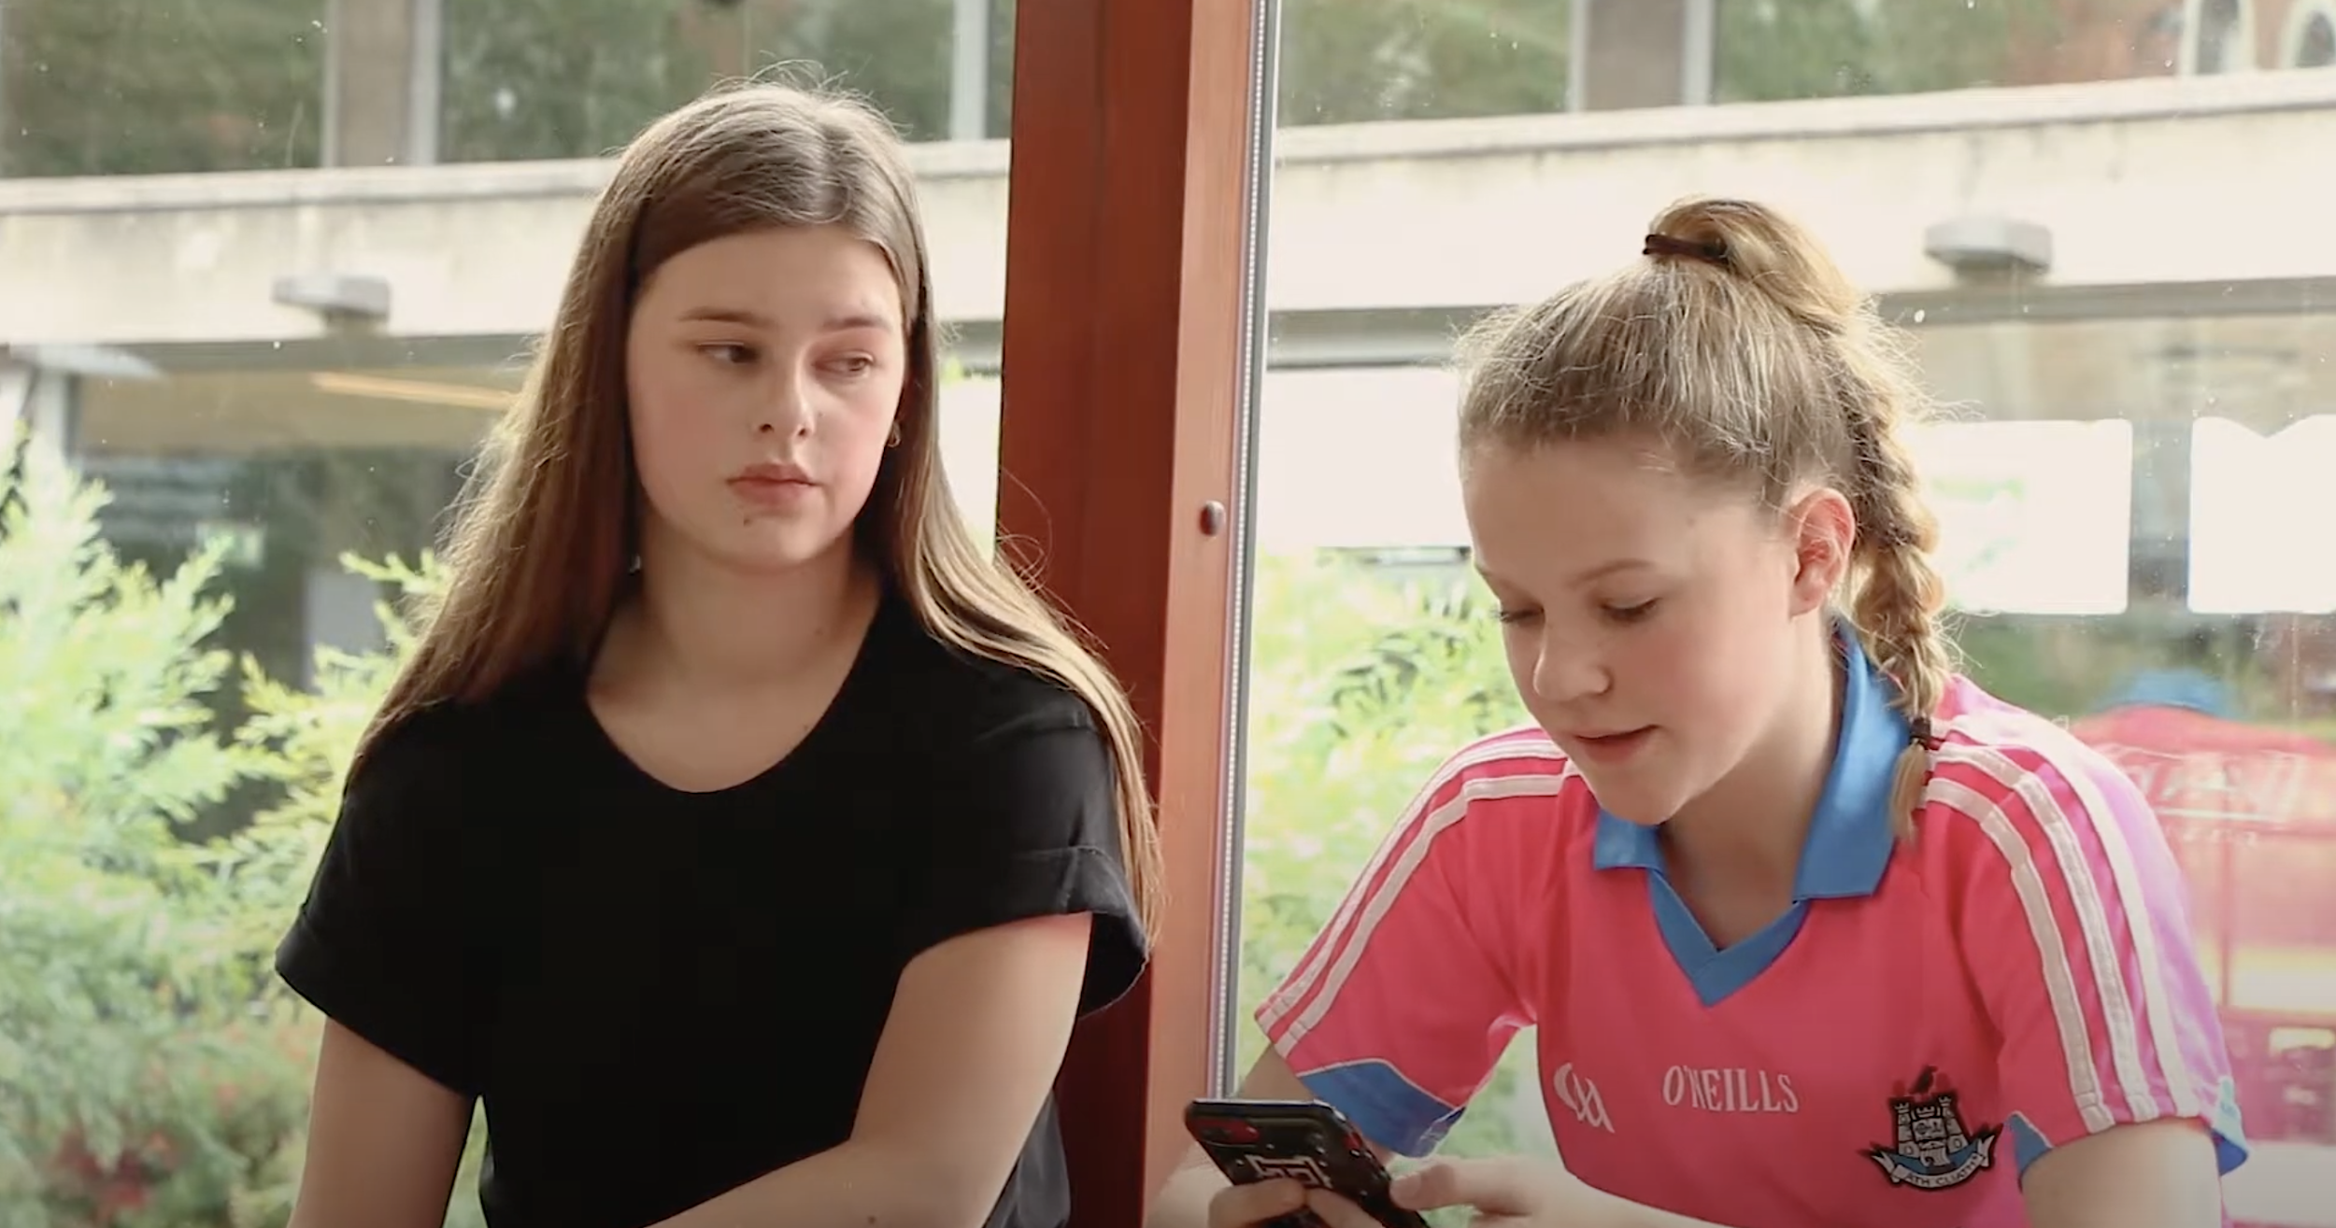
How would you feel if you were Shane & Laura?
FUSE | ANTI- BULLYING & ONLINE SAFETY PROGRAMME
Notes:
Activity 3.2
This is a group activity.
Split the students into 3 groups.
This activity focuses on the feelings of those involved in bullying/cyberbullying incidents.
Students should imagine that they are Shane / Laura, or the kids who bully Shane/Laura or the kids and who witness what is happening.
Each group will be allocated one of the following questions:
1. How might you feel if you were Shane/Laura?
2. How might you feel if you were one of the kids who bully Shane/Laura?
3. How might you feel being present while Shane/ Laura were being bullied?
Students will list their response to the question allocated.
After the activity, the students will then discuss their responses.

Slide 9
Positive school environment
FUSE | ANTI- BULLYING & ONLINE SAFETY PROGRAMME
Notes:
Activity 3.3
This is a group activity.
The aim of this activity is to develop guidelines to create a positive school environment supporting students to overcome their negative feelings.
Split the students into 3 groups.
Each group is assigned one of the following tasks:
1. Devise five ways or measures school staff can make you feel more supported.
2. Devise five ways you can promote positive relationships with other pupils.
3. Devise five questions other students can use to get to know each other better.
Students will devise ways on how to make their school environment more positive.
Students will then discuss their responses or the teacher will invite students to discuss their responses.

Slide 10
Things to consider…
How would you feel if you were in Shane or Laura’s position?
Respect everyone!
The effect bullying can have on someone's feelings.
The benefits of a positive school environment
Empathy is someone's ability to experience & understand someone else's feelings, emotions and perspectives
FUSE | ANTI- BULLYING & ONLINE SAFETY PROGRAMME
Notes:
This slide acts as a recap of the workshop and provides the students with a consolidated overview of the learnings you have discussed to-date.

Slide 11
Reflection activity
In this lesson I learned
1
2
3
4
5
Notes:
The importance of this workshop is to in still the idea of empathy, positive relationships, and apositive school climate.

Slide 12
Help & Support
FUSE | ANTI- BULLYING & ONLINE SAFETY PROGRAMME

Slide 13
THANK YOU
The importance of this module is to in still the idea of empathy, relationships, and positive school climate.
For more information please go to www.fuse.ie

