Slide 1
Anti-Bullying and Online Safety
Post-Primary School Programme
WORKSHOP 4:
Bystanders and Responsibility

Slide 2
WHAT HAVE WE LEARNED SO FAR?
FUSE | ANTI- BULLYING & ONLINE SAFETY PROGRAMME
Notes:
The teacher should recap on the learning outcomes from the previous workshop and then proceed.

Slide 3
WHAT IS A BYSTANDER?
FUSE | ANTI- BULLYING & ONLINE SAFETY PROGRAMME
Notes:
The teacher will provide the answer to the question in the next slide:
What is a bystander?
Students should share their ideas during a class discussion.

Slide 4
A
WHAT IS A BYSTANDER?
A bystander is the person or persons that witness bullying when it happens or that notice bullying behaviour
FUSE | ANTI- BULLYING & ONLINE SAFETY PROGRAMME
Notes:
This slide emanates from the previous one.
Here the teacher will provide the answer to the question “What is a bystander”?
A bystander is the person or persons that witness bullying when it happens or that notice bullying behaviour

Slide 5
Notes:
In this slide students will watch a video of Shane’s story that portrays the various types of bystanders - https://youtu.be/acyRVUpWk0g

Slide 6
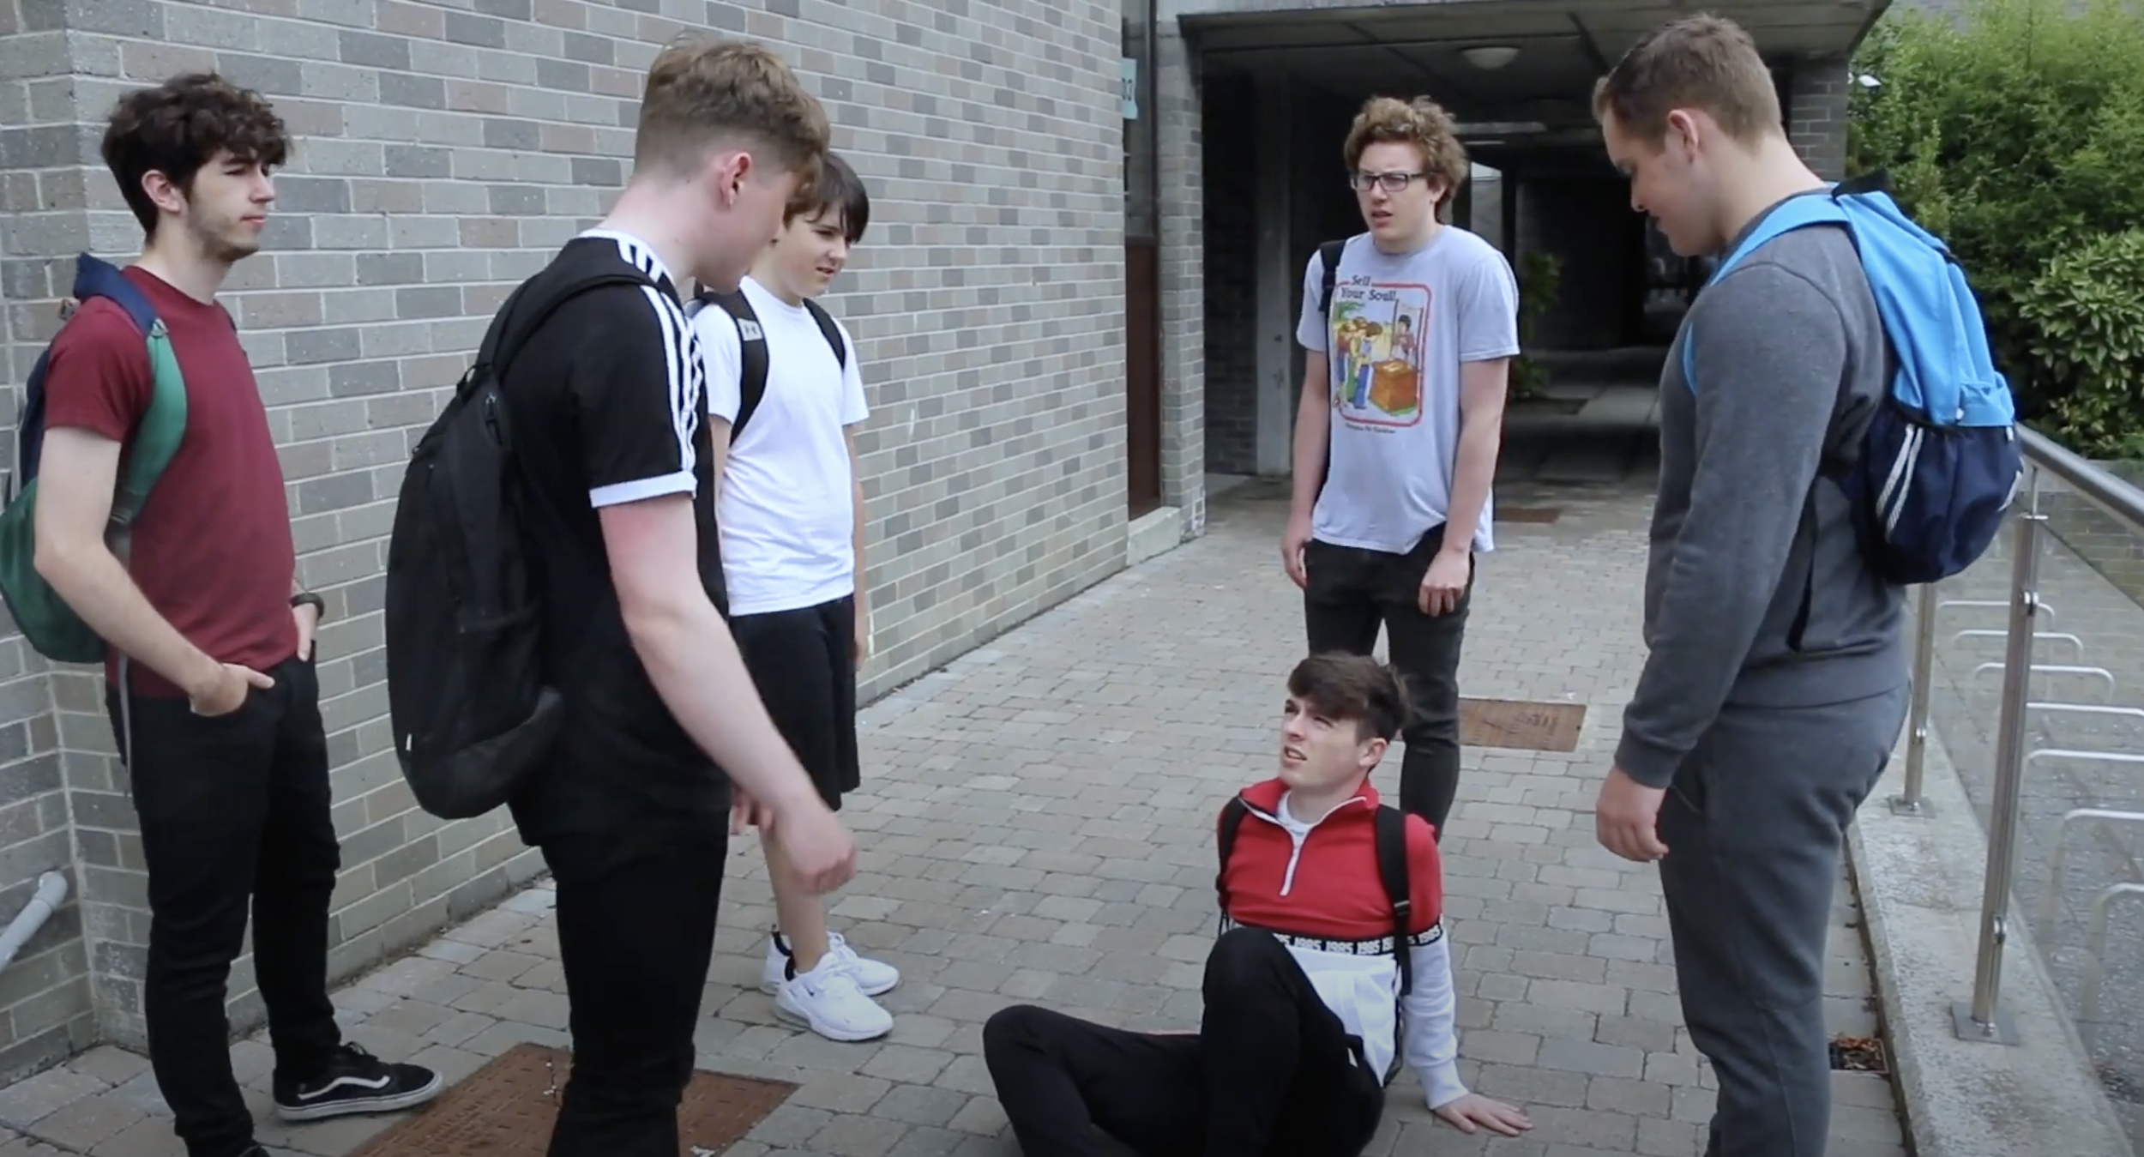
Bystanders Offline What is each person doing in this video?
Notes:
Activity 4.1
Students will complete the activity based on the video they watched
.
Students are asked to view the pictures of the people involved in the incident and describe what each one is doing in the video.
After they have completed the activity, the students should discuss their answers in the classroom.

Slide 7
Types of Bystander Offline
Defenders
Someone who comforts the target
Encourages him/her to tell the teacher
Tells the others to stop bullying
Tries to stop the bullying
Outsiders
Someone who is not usually present in the bullying situation
Stays outside the situation
Does not take sides with anyone
Assistants
Joins in the bullying when someone else has started it
Supports / helps the bully
Reinforcers
Someone laughing, and inciting the bully by shouting or saying, “Show him/her!”
Notes:
In this slide the teacher will explain to students the different types of bystanders offline.

Slide 8
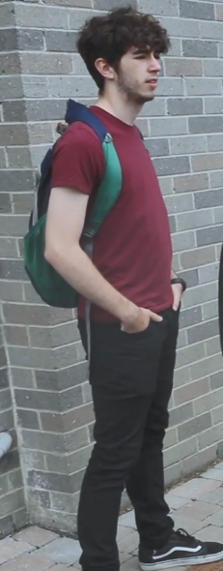
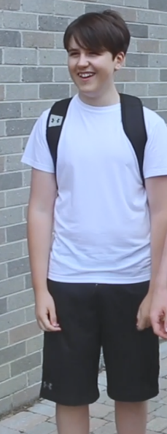
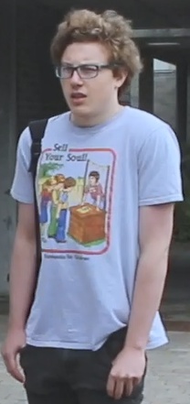
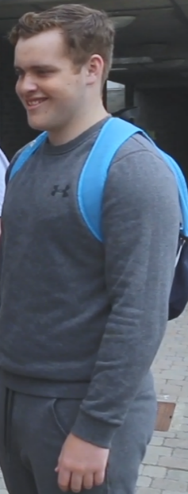
Can you identify the bystanders Offline?
Assistants | Picture 1
Reinforcers | Picture 2
Outsiders | Picture 3
Defenders | Picture 4
1
2
3
4
Notes:
This is an activity-based slide (Activity 4.2).
Activity 4.2
This is an individual activity.
Students are to complete the activity based on the video they watched.
Students should view the images of the different types of bystanders (people involved in the incident) in the Activity 4.1 and match which image (character) corresponds to the specific type of bystander.
After the activity, the students will discuss their responses in the classroom.
The teacher should clarify that bystanders play the same role both online and offline. We encourage positive bystander behaviour both online and offline.
Answers
Picture 1 = Defender
Picture 2 = Assistant
Picture 3 = Outsider
Picture 4 = Reinforcer

Slide 9
Types of Bystander Online
Defenders
They try to stop/ intervene in bullying behaviour in an active way and support the victim
E.g. They report the content they come across online
Outsiders
They do not take sides
They sit on the fence
They may support or condemn silently but do not intervene
E.g. They see bullying online but scroll on
Assistants
They join in the bullying behaviour and support the bully
E.g. They “like” comments/pictures/
videos online
Reinforcers
They do not attack the target directly but they support the bully
E.g. They add more comments online and share the content
Notes:
In this slide the teacher will explain to students the different types of bystanders online.

Slide 10
Scenario 1
Last Friday night, Mario came home after being at the cinema with his friends. They are all preparing for the leaving cert, and his friend Andrew did not show up. Perhaps he was studying...
After dinner, Mario goes to his room and is flicking through his Instagram stories. To his surprise he sees an Instagram poll on the schools’ confession page with the question who in St Patrick’s School will fail the leaving cert? It is a multiple choice poll. All answers have the name: Andrew.
This infuriates Mario. Andrew is a friendly kid who just does his own thing. Mario decided to direct message the page to ask them to take it down and he also reported the story on Instagram.
Mario reaches out to Andrew to see that he is ok.
Notes:
Bystanders – What is each person doing in the scenario
This is an activity-based slide (Activity 4.3).
Activity 4.3
This is a group activity.
You will be split into 5 groups. Each group will be assigned to one scenario. You will need to complete the activity based on the scenario you are assigned.
Look at the scenario of the different types of bystanders (people involved in the incident) and decide which type of bystander corresponds to the character of your scenario.
Is the person a defender, outsider, assistant or reinforcer?
After the activity, discuss your answers in the classroom.
Mario is a Defender

Slide 11
Scenario 2
Last Friday night, John came home after the cinema with his classmates. They are all preparing for the leaving cert and there are tensions among the group. After dinner, John goes to his room and is flicking through his Instagram stories. He sees an Instagram poll on the schools’ confession page with the question who in St Patrick’s School will fail the leaving cert? It is a multiple choice poll. All answers have the name: Andrew.
Andrew is a friendly kid who just does his own thing. John knows him from school but they are not friends and rarely even talk. John thinks that the poll is a bit harsh, and thinks that his mate Robert is behind the school confessions page but isn't sure.
John puts his headphone on, opens Spotify and ignores it.
Notes:
This is an activity-based slide (Activity 4.3).
Activity 4.3
This is a group activity.
You will be split into 5 groups. Each group will be assigned to one scenario. You will need to complete the activity based on the scenario you are assigned.
Look at the scenario of the different types of bystanders (people involved in the incident) and decide which type of bystander corresponds to the character of your scenario. Is the person a defender, outsider, assistant or reinforcer?
After the activity, discuss your answers in the classroom.
John is an Outsider

Slide 12
Scenario 3
Last Friday night, James came home after the cinema with his classmates. They are all preparing for the leaving cert and there are tensions among the group. After dinner, James goes to his room and is flicking through his Instagram stories. To his surprise he sees an Instagram poll on the schools’ confession page with the question who in St Patrick’s School will fail the leaving cert? It is a multiple choice poll. All answers have the name: Andrew.
Andrew is a friendly kid who just does his own thing. James knows him from school but they are not friends and rarely even talk. James decides to vote on the poll and sends it to some of his friends telling them to vote on it.
Notes:
This is an activity-based slide (Activity 4.3).
Activity 4.3
This is a group activity.
You will be split into 5 groups. Each group will be assigned to one scenario. You will need to complete the activity based on the scenario you are assigned.
Look at the scenario of the different types of bystanders (people involved in the incident) and decide which type of bystander corresponds to the character of your scenario. Is the person a defender, outsider, assistant or reinforcer?
After the activity, discuss your answers in the classroom.
James is an Assistant

Slide 13
Scenario 4
Last Friday night, Jane came home after the cinema with her classmates. They are all preparing for the leaving cert and there are tensions among the group. After dinner, Jane goes to her room and is flicking through her Instagram stories. To her surprise she sees an Instagram poll on the schools’ confession page with the question who in St Patrick’s School will fail the leaving cert? It is a multiple choice poll. All answers have the name: Andrew.
Andrew is a friendly kid who just does his own thing. Jane knows him from school but they are not friends and rarely even talk.
Jane’s friend runs the confession page. She decides to vote on the poll and messages the page to put up another poll about Andrew and other classmates.
Notes:
This is an activity-based slide (Activity 4.3).
Activity 4.3
This is a group activity.
You will be split into 5 groups. Each group will be assigned to one scenario. You will need to complete the activity based on the scenario you are assigned.
Look at the scenario of the different types of bystanders (people involved in the incident) and decide which type of bystander corresponds to the character of your scenario. Is the person a defender, outsider, assistant or reinforcer?
After the activity, discuss your answers in the classroom.
Jane is a Reinforcer

Slide 14
Scenario 5
Last Friday night, Clarissa was home after being at the cinema with her friends. They are all preparing for the leaving cert and it is a stressful time for everybody.
Clarissa takes her phone out and is flicking through Instagram. She comes across a page with a number of posts that are all incredibly misogynistic and demeaning towards women.
Clarissa sends this to her group of friends on WhatsApp. She encourages them to report the page and posts to Instagram.
Notes:
This is an activity-based slide (Activity 4.3).
Activity 4.3
This is a group activity.
You will be split into 5 groups. Each group will be assigned to one scenario. You will need to complete the activity based on the scenario you are assigned.
Look at the scenario of the different types of bystanders (people involved in the incident) and decide which type of bystander corresponds to the character of your scenario. Is the person a defender, outsider, assistant or reinforcer?
After the activity, discuss your answers in the classroom.
Clarissa is a Defender

Slide 15
Why we all must take responsibility
Why do some bystanders not take action towards online/offline bullying?
FUSE | ANTI- BULLYING & ONLINE SAFETY PROGRAMME
Notes:
This is a discussion-based slide.
The teacher should facilitate a discussion on the possible reasons why bystanders do not, in all cases, offer support and assistance when bullying occurs.
Some possible reasons may include:
» They may be concerned for their own safety
» They don’t know what they should do to help
» Afraid that they might be picked on
» They are friends with the perpetrators
» Assume someone else will help
» Feel they could get in trouble

Slide 16
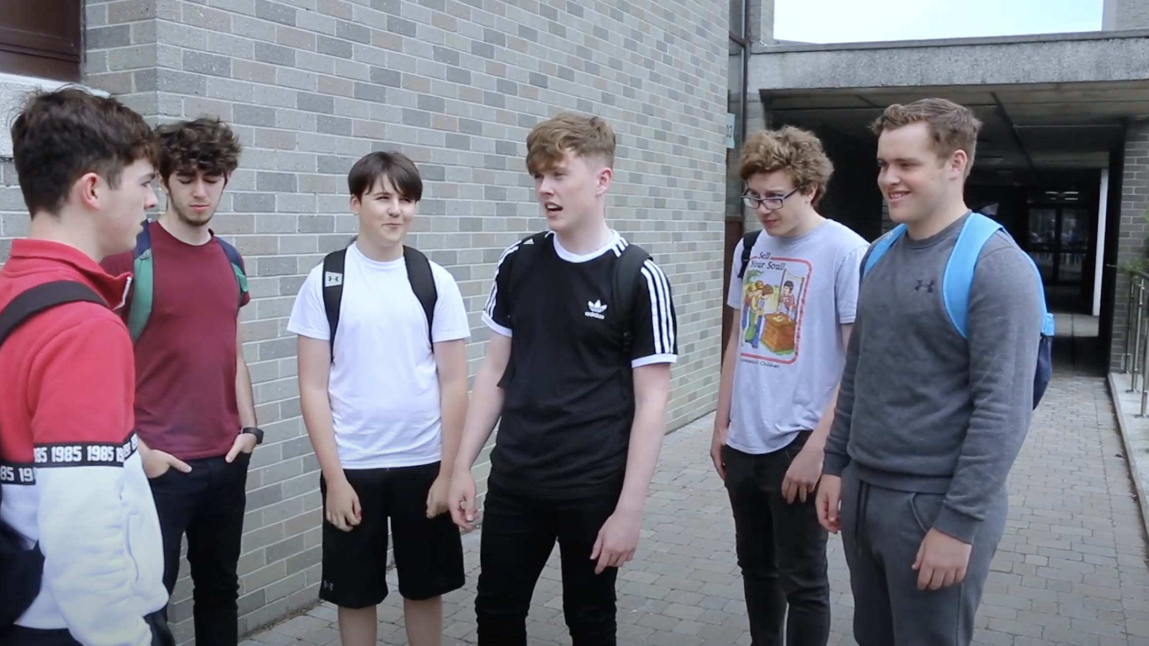
DO WE EXPECT OTHERS TO STEP IN?
FUSE | ANTI- BULLYING & ONLINE SAFETY PROGRAMME
Notes:
This is a discussion-based slide.
Students will have to think about the video they watched earlier and recall the situation in order to discuss the following questions:
Did anyone take responsibility here?
If so, how did they take responsibility?
Could they have done more to help? If so, what more could they have done?
Were there any bystanders who didn't do anything?
What is this person called again?
Why do you think they didn't do anything?
Students should also come up with the idea that the bystanders perhaps do not intervene because they expect someone else to do something.
If they don’t mention this, then ask the following question:
“Do you think that we expect others to step in when they see bullying behaviour?”
Explain to your students that this is called “diffusion of responsibility”, when someone is expecting someone else to take action and they themselves do nothing.
To explain this concept, you can also use the following questions in order to get your students to think about it:
If you’ve ever witnessed bullying, have you expected someone else to do something about it while you ignored it?
Do you think that you have a responsibility to do something when someone is being bullied?

Slide 17
FUSE | ANTI- BULLYING & ONLINE SAFETY PROGRAMME
Notes:
In this slide students should watch a video about Shane’s story (Part 2) which attempts to show what to do to
stop a bullying incident:
https://youtu.be/1gNRkkBhy-I

Slide 18
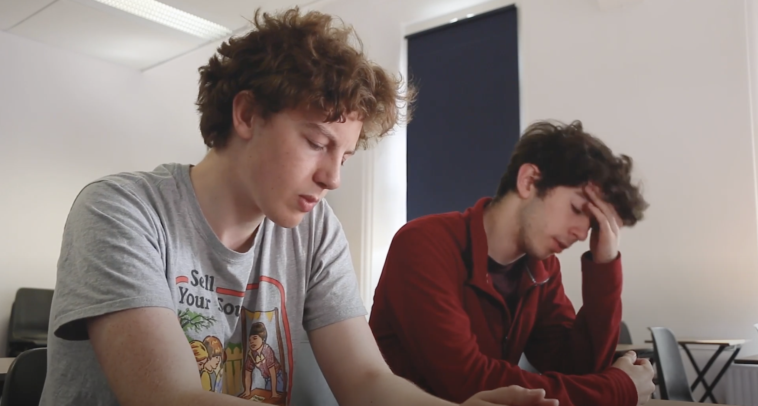
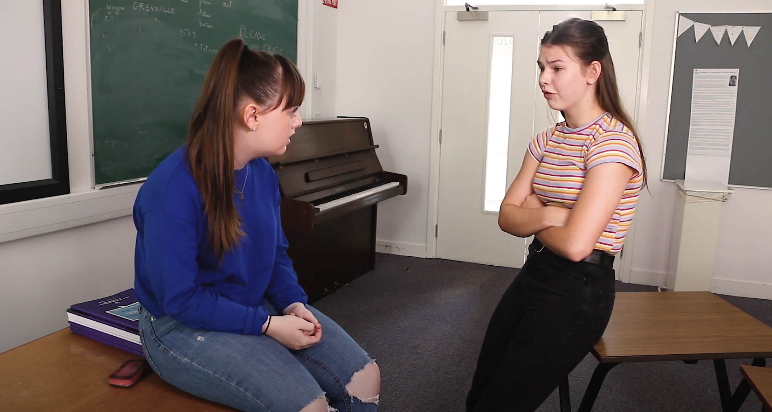
What can bystanders do to help? What can targets of bullying do?
FUSE | ANTI- BULLYING & ONLINE SAFETY PROGRAMME
Notes:
This is an activity-based slide (Activity 4.4).
Activity 4.4
This is a group activity.
You will be split into groups. Discuss within your groups the following:
What can Bystanders do to help?
What can people being bullied do?
Then write the solution to the above questions in the space provided.
After you have completed the activity, discuss your answers in the classroom.
The aim of this activity is for students to come to the conclusion that they should report bullying incidents.
But there are other things they can do ... What can bystanders do to help?
» Refuse to be the audience, go get help
» Label it as bullying
» Tell the bully to leave the person alone
» Say something that lets the other students know it’s not ok
» Distract the bully and talk about something else
» Always report bullying to an adult
» If it is online, report it and message the target with support
» Talk to your friends for advice on how you can help
» Talk to the person and let them know you care
Standing up when you’re targeted can be difficult. The fastest way to resolve bullying is to ... Ask for help.
What can victims (targets) of bullying do?
» Report anonymously to the school;
» Send an email, write a note, tell a teacher/parent or a trusted adult.
» Tell your friends or siblings.
» You always report bullying.
» Remember that if you report bullying to your school it will not get worse - it’s the first step to resolving it!
Common goal is to report!

Slide 19
What can Bystanders/Targets do?
FUSE | ANTI- BULLYING & ONLINE SAFETY PROGRAMME
Notes:
These slides emanates from the previous activity.
Students should understand that the most efficient way to stop bullying (either as a bystander or as a victim) is to report it to an adult.
“Reporting is when you seek out an adult you trust for help.”

Slide 20
A
What can Bystanders/Targets do?
REPORT IT!!!
Reporting is when you seek out an adult you trust for help.
FUSE | ANTI- BULLYING & ONLINE SAFETY PROGRAMME
Notes:
These slides emanates from the previous activity.
Students should understand that the most efficient way to stop bullying (either as a bystander or as a victim) is to report it to an adult.
“Reporting is when you seek out an adult you trust for help.”

Slide 21
Things to consider…
We all play a role in bullying.
Be part of the solution and not the problem
All the kids represent a different type of Bystander
We must take responsibility ourselves when we witness bullying.
Reporting bullying
Is very important
FUSE | ANTI- BULLYING & ONLINE SAFETY PROGRAMME
Notes:
This slide acts as a recap of the workshop and provides the students with a consolidated overview of the learnings you have discussed to-date.

Slide 22
Reflection activity
In this lesson I learned
1
2
3
4
5
Notes:
The importance of this workshop is to instill the idea of bystanders, diffusion of responsibility, and that reporting is the most efficient way to stop bullying.
Students need to consider what they have learned during the workshop.

Slide 23
Help & Support
FUSE | ANTI- BULLYING & ONLINE SAFETY PROGRAMME

Slide 24
THANK YOU
For more information please go to www.fuse.ie

