Slide 1




Anti-Bullying and Online Safety
FUSE Programme for Schools
Lesson 3:
Hate Speech

Slide 2
GROUND RULES
Welcome to the lesson.
Everyone is included in the lesson.
Students take turns. Raise your hand if you would like to participate in the discussion.
Be mindful and respectful of other people’s opinions.
Follow the teacher’s directions.

Slide 3
Learning Outcomes
Understand the definition(s) of hate speech
Reflect on and identify the difference between hate speech and bullying behaviour
Understand how hate speech affects diverse minorities online
Examine how to deal with and respond to online/offline hate speech
Notice when hate speech turns into bullying behaviour and know how to safely report it

Slide 4
What is Hate Speech? Video Discussion & Reflective Questions
https://www.youtube.com/watch?v=JdAYUD256Mc
Source: DCU Anti-Bullying Centre / YouTube

Slide 5
REFLECTIVE QUESTIONS
What is hate speech?
Who are often the targets of hate speech?
What can hate speech encourage?
What happens to hate speech when conducted online?
When do you think hate speech turns into bullying? *If it is repeated.
How do you think we can address hate speech when it occurs?
?
?
?

Slide 6
Activity Sheet 1: Bullying Behaviour or Hate Speech?
You will be presented with examples of bullying behaviour and/or hate speech
You will decide which incidents are examples of bullying behaviour and which incidents are examples of hate speech, and what type of bullying behaviour or hate speech it is.

Slide 7
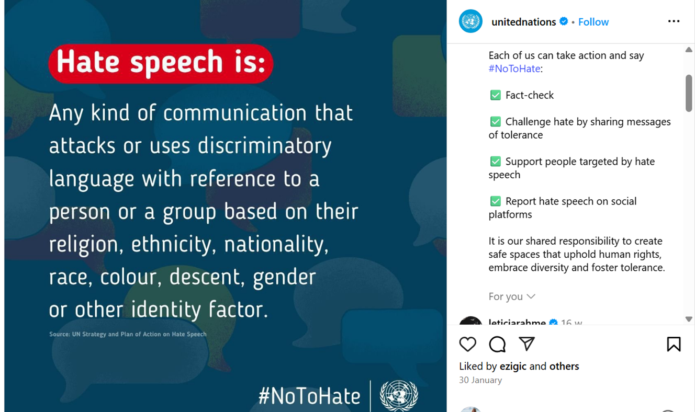
HATE SPEECH

Slide 8
HATE SPEECH IS:
Any kind of communication that aims to make a group of people or a person belonging to that group socially inferior to the rest. Usually, the targeted groups are black, women, LGBTQIA+, Muslims, Roma, Travellers, Refugees, Transgender.
Common characteristics of Hate Speech targets:
Race
Sexual orientation
Gender
Functional diversity (special needs, disability, impairment)

Slide 9
Bullying Definition
Bullying is targeted behaviour, online or offline, that causes harm. The harm caused can be physical, social and/or emotional in nature. Bullying behaviour is repeated over time and involves an imbalance of power in relationships between two people or groups of people in society.
Cineáltas Action Plan on Bullying, 2022

Slide 10
REFLECTIVE QUESTIONS
Why did you label the scenario as bullying behaviour or hate speech?
Could any other group have fitted the scenario?
What would you do in a similar situation?
What changes could you make to improve the scenarios?
?
?
?

Slide 11
Difference between Hate Speech and Bullying behaviour
Bullying behaviour is | Hate speech is
Negative power relations over individuals | Hostility and violence against an entire group of people that the individual represents
Target can be anyone | Targeting an individual or group due to the characteristics of the target
Aims to undermine the individual | Aims to undermine what the individual represents
Occurs on repetitive occasions | One incident is enough (doesn’t need to be repetitive)
Has individual effects | Has effect on a group on society
*You can experience bullying behaviour through Hate Speech if it is repetitive*

Slide 12
Hate Speech Offline & Online
If the expression is discriminatory, as it seeks to subordinate groups for their common characteristics, it is hate speech; however:
The difference between hate speech offline and online is that on social media, hate speech travels and grows at a rapid rate and has the potential to affect more people, with a wider reach.

Slide 13
Video - Understanding how hate speech affects diverse minorities online
https://youtu.be/keqLWH0YZV0?si=rzJZviw8FgccDmKC
Source: NohatespeechMovement
YouTube

Slide 14
Key Questions
What happened in the video?
What was she being targeted for?
What do you think that someone should do in this situation?
How do you know that this is an example of hate speech?
If you saw this type of comment on a friend’s profile, what could you do?
?
?

Slide 15
The targets of Hate Speech feel
Undermined
A lack of security
Deep confusion due to the attack and why it happened
The attack happens due to the individual belonging to a group. Therefore, the attack is not about the individual but the group they belong to, and this has a negative effect on their entire community.
Understanding how Hate Speech affects individuals, groups, and communities

Slide 16
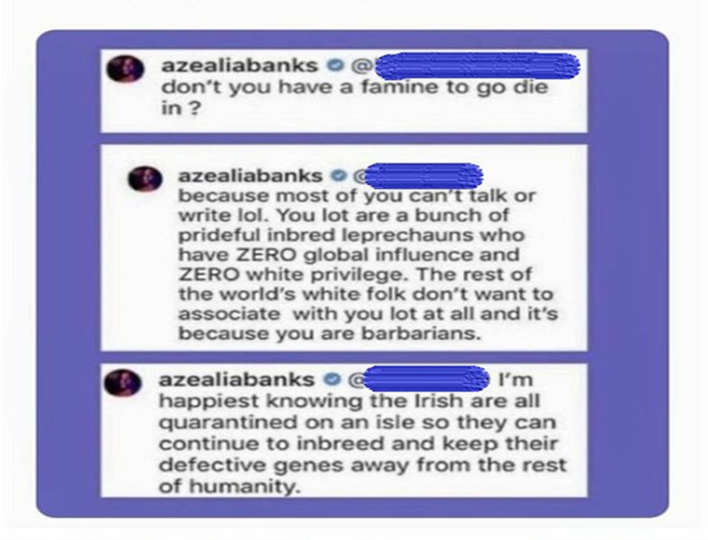
Class Discussion: How does this Tweet make you feel?

Slide 17
KEY QUESTIONS
What do you think these comments are about?
How do you feel reading these comments?
Who are these comments directed at?
Who is affected by these comments?
Do you think this is an example of hate speech?
?
?
?

Slide 18
Hate Speech on Instagram
Online platforms such as TikTok and Instagram must follow Ireland’s Online Safety Code, which imposes obligations on these platforms to protect people from online harm and harmful content.
Instagram will now:
Disable someone's account if they continue to send violating or abusive messages
Cooperate with law enforcement authorities on hate speech
Use AI to warn people when they are about to post something harmful
Use comment filters to allow people to filter out hurtful words or comments they do not want to see.
https://about.instagram.com/blog/announcements/introducing-new-tools-to-protect-our-community-from-abuse#:~:text=Because%20DMs%20are%20private%20conversations,never%20have%20to%20see%20them

Slide 19
What can I do?
Once you notice hate speech or bullying behaviour online, you should report it. Hate speech or online bullying is never okay.
Students can:
Report harmful comments or posts on the relevant apps using the report tool.
Filter out harmful words and phrases you don't want to see in requested messages on Instagram using the filter tool.
Filter out offensive words, phrases, or emojis that you don’t want to see.
Continue to stay informed about your digital rights and privacy settings.
Report any harmful content, comments, or something that doesn’t make you feel safe to a trusted adult, parent, or teacher.
Always fact-check before you post anything online.

Slide 20
Activity Sheet 2: How to respond to hate speech
Think of an example of hate speech (that you might have heard or seen recently).
Write the potential causes of the hate speech/comment on the roots of the tree and its effects on the branches.
Then, write on the clouds what actions you can take to tackle this incident
Discuss whether these ideas could be used in your school to tackle this incident.

Slide 21
Dealing with Hate Speech
If hate speech is unchallenged, it further deepens into negative stereotypes, groups become increasingly marginalized and isolated, and society loses one of its major values: diversity
Any instances of online bullying behaviour or hate speech should always be reported.
Students should only take action if they feel safe to do so and it does not put them at any risk

Slide 22
Lesson Closure
What have you learnt from today’s lesson?
Write down the three most important things you learnt during today’s lesson.

Slide 23






Help and Support

Slide 24



THANK YOU
For more information, please go to www.fuseprogramme.ie

